Slide 1
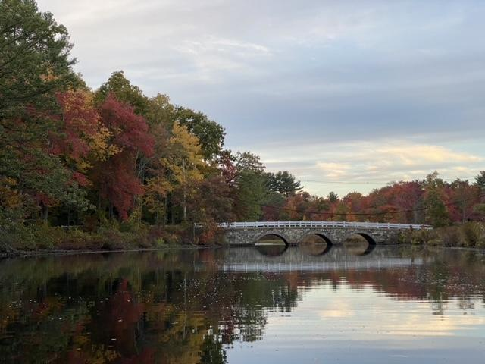
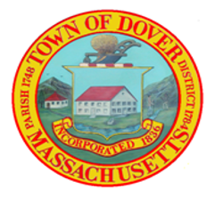
Town of Dover
DOVER WATER USE RESTRICTION BYLAW
February 17, 2022
Staff Presentation

Slide 2
Project Background and Process
Purpose
Implementation of BOH WRC recommendations:
Draft a Water Use Restriction Bylaw
Consider Water Irrigation System Registration General Bylaw
Process to Date
1. Initial Research of Local Bylaws
Case Studies: Franklin, Medfield, Ashland, and Concord
DEP Template (2018 Updated Version)
2. Review Legal Framework
3. Draft Bylaw
4. Targeted Feedback: Internal Review (legal & Aquarion)
5. Second Draft
6. WRC Review
7. Final Review w/Legal
First Draft
Targeted Feedback
Second Draft
Final Draft for TM
Adoption at TM
BOS/ Warrant Feedback
WRC Feedback
Notes:
MassDEP developed the Model Outdoor Water Use Bylaw/Ordinance to help municipalities and water districts implement seasonal conservation of water supplied by public water systems (PWS). The Model Bylaw also includes options for regulating private wells and in-ground irrigation systems.
Additionally we reviewed what other local communities had used, and they were all based off the DEP template as well.

Slide 3
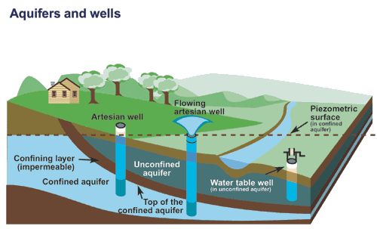
Regulatory Background
Private Wells
Private and public wells draw from the same aquifers – protecting the water supply requires both to be regulated
Data Sources
DEP
Kleinfelder Hydrology Study
Monitoring Wells
Mass River Alliance report
Private Wells are regulated in:
  Falmouth
  Hamilton
  Wenham
Notes:
Private wells impact public water supplies and the environment Wells generally draw on the same groundwater reserves that support public water supplies and sustain streams and rivers.
Private wells create equity issues When neighbors have different watering restrictions, it raises concerns about fairness.
Private wells create enforcement issues Enforcement becomes increasingly challenging when some water users must follow restrictions and others do not.

Slide 4
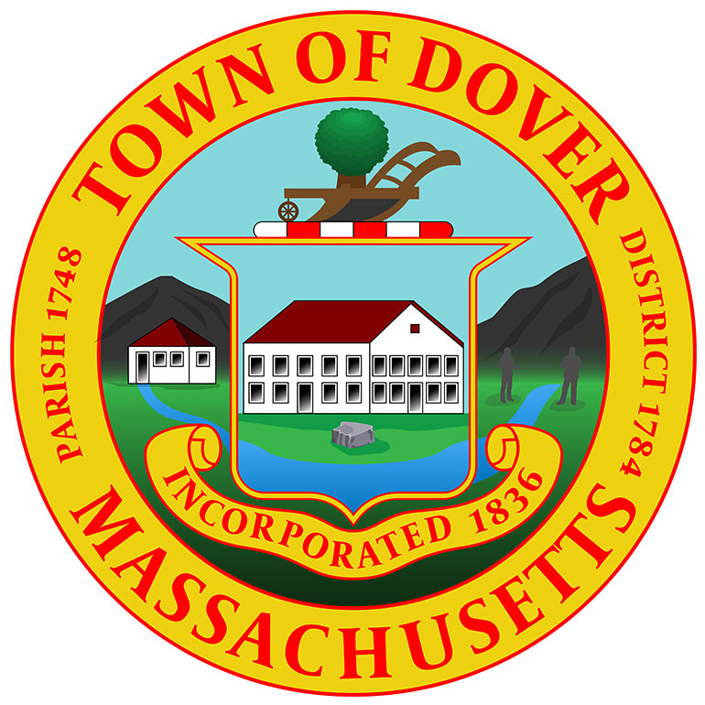

Authority and Purpose
Authority: is granted by the Home Rule Charter and the Department of Environmental Protection
Purpose: The purpose of this bylaw is to protect, preserve and maintain the public health, safety, welfare, and the environment whenever there is in force a “State of Water Supply Conservation”, “State of Drought”, or a “State of Water Supply Emergency”, , by ensuring an adequate supply of water safe for drinking and fire protection and to protect the quality and quantity of water in local aquatic habitats such as ponds, rivers, and wetlands.

Slide 5
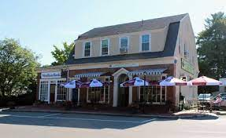
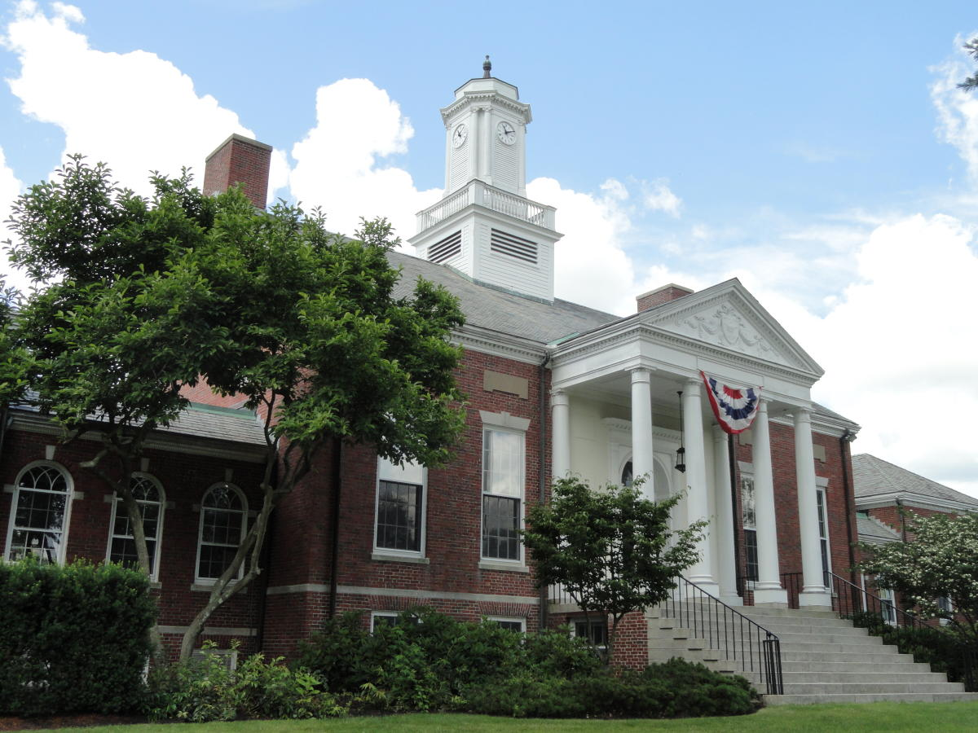
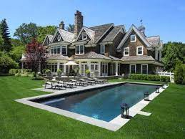
Applicability
All public and private users of the Town of Dover’s public water system and/or of groundwater within the borders of the Town of Dover.

Slide 6
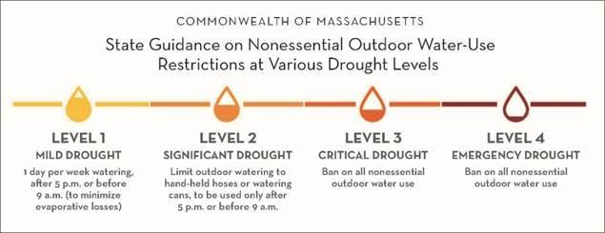
Regulations
The following Declarations Restrict Water Use:
Declaration of a State of Water Supply Conservation.
The Board of Selectmen
Declaration of a State of Water Supply Emergency.
Department of Environmental Protection
Declaration of a State of Drought
Department of Environmental Protection
Notes:
Restricted Uses:
Nonessential outdoor water use. This could mean restrictions on the days, hours or methods of outdoor water use.
Ban on outdoor water use
Prohibition on use of automatic sprinklers

Slide 7
Public Notification
Notification of water use restrictions must be issued within 48 hours of a Declaration of a State of Water Supply Conservation, Water Supply Emergency, or Drought.
Communication Method | Contact
Town Website | Dave Sullivan & Kate O’Brien
Town Social Media | Kate O’Brien & Courtney Starling
Bulletin Boards | Kate O’Brien
Outdoor Signage | BOH/Bobby Tosi
Email Alerts | BOH/Dave Sullivan
Text Alerts (CodeRED) | Emergency Mgmt
Public Meetings | Chris Dwelley

Slide 8
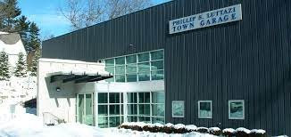
Enforcement
Departments of Public Works are most commonly responsible for enforcement of water use restrictions in Massachusetts communities with Water Use Restrictions – it is intended the Dover’s DPW will enforce Dover’s regulations.

Slide 9
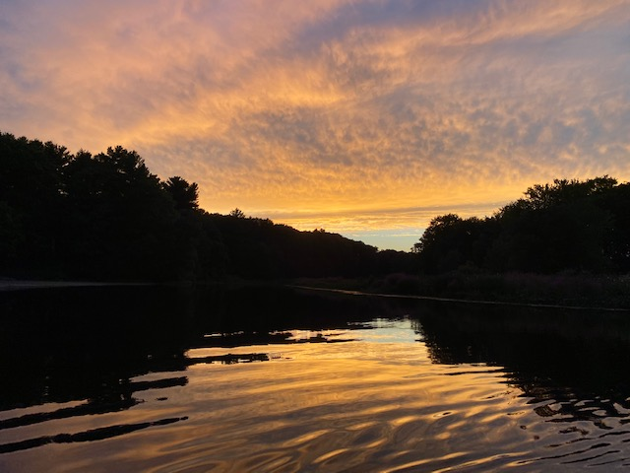
Questions and Comments
Thank you for your time.

