Slide 1

Dover Community Center Project
Timelines and Costs to Meet the Board of Selectmen’s Charge
  October 3, 2022
  Prepared by: Colliers Project Leaders
Accelerating success.

Slide 2
Agenda
Review Options Requested by Board of Selectmen
  Option 1 – Rebid the project as currently designed
  Option 2 – Develop alternative facility design to meet our current budget of $18.85M
  Option 3 - Alter existing design to expedite re-design process
  Pembroke Community Center Analysis
  Design Peer Review
  Discussion

Slide 3
Option 1: Re-Prequal & Re-Bid
Process Includes:
Prepare documentation
Contractor prequalification
Solicit contractor bids
Review bids
Present bids to Building Committee
Present GC Award Recommendation to BOS
March 2023 Special Town Meeting for Budget Overage (assumed)

Slide 4
Option 1: Re-Prequal & Re-Bid
Timeline and Costs
NOV-DEC
JAN-FEB
MARCH
APRIL 2023 – MAY 2024
JUNE - JULY
Docs & Prequal
Bid
STM
Construction
Closeout
Additional Soft Costs for the 5-Month Re-Prequal & Re-Bid Process
OPM: $110K+/-
Designer: $175K+/-
Bid Hosting: $10K+/-
Advertising: $2K+/-
TOTAL: $300K+/-
*Assumes Project resumes November 1, 2022*
**Doesn’t include additional construction costs or contingency**

Slide 5
Option 2: Re-Design, Re-Prequal & Re-Bid to Existing Budget Starting NOW
Process Includes:
Re-evaluate the building program with the Owner
Evaluate multiple design alternatives and select a preferred option
Engage the community throughout the process
Produce new design documents: Schematic Design(SD), Design Development(DD) and Construction Documents(CD)
Perform cost estimates: SD, DD and CD
Perform value engineering
Contractor prequalification
Solicit contractor bids
Review bids
Present bids to Building Committee
Present GC Award Recommendation to BOS

Slide 6
Option 2: Re-Design, Re-Prequal & Re-Bid to Existing Budget Starting NOW
Timeline and Costs
NOV 2022 – OCT 2023
NOV-DEC
JAN
FEB 2024 – MARCH 2025
APRIL - MAY
Design
Prequal
Bid
Construction
Closeout
Prequal
STM
Additional Soft Costs for the 12-month design process, 2-month bidding process and STM
OPM: $270K+/-
Designer: $1.4M+/-
Cost Estimator: $30K+/-
Bid Hosting: $10K+/-
Advertising: $2K+/-
TOTAL: $1.7M+/-
New Construction Budget
$12.5M | $11.65M if Recreational Court is reduced in size due to appropriation for add’l 1,000 NSF
Construction Costs
$830/SF (June 1st Bid) + 10.67% (Dec. 2023 GC Bid) = $920/SF
$12.5M / $920/SF = 13,600 GSF Building Size (6,400 GSF less than current)
$11.65M / $920/SF = 12,660 GSF Building Size (Excludes Gym | 7,340 GSF less than current)
Total Project Budget = $18.85M
*Assumes Project resumes November 1, 2022*

Slide 7
Option 3: Alter Existing Design to Expedite Re-Design Process
Process Includes:
Utilize the current building program, minus the Recreational Court, Community Room, Kitchen and Café in order to expedite the re-design process
Produce new design documents: Schematic Design(SD), Design Development(DD) and Construction Documents(CD)
Perform cost estimates: SD, DD and CD
Perform value engineering
Contractor prequalification
Solicit contractor bids
Review bids
Present bids to Building Committee
Present GC Award Recommendation to BOS

Slide 8
Option 3: Alter Existing Design to Expedite Re-Design Process
Timeline and Costs
APRIL 2023 – SEPT 23
OCT-NOV
DEC
JAN 2024 – FEB 2025
MARCH - APRIL
Design
Prequal
Bid
STM
Construction
Closeout
Additional Soft Costs for the 5-Month Re-Prequal & Re-Bid Process
Designer, OPM, etc. for Option 1’s RePrequal & ReBid = $300K+/-
Additional Soft Costs for 6-Month Re-Design, 2-Month Bid Process and STM
OPM: $160K+/-
Designer: $1M+/-
Cost Estimator: $30K+/-
Bid Hosting: $10K+/-
Advertising: $2K+/-
TOTAL = $1.5M+/-
New Construction Budget
$12.7M - $850K (Recreation Court Appropriation) = $11,850,000

Slide 9
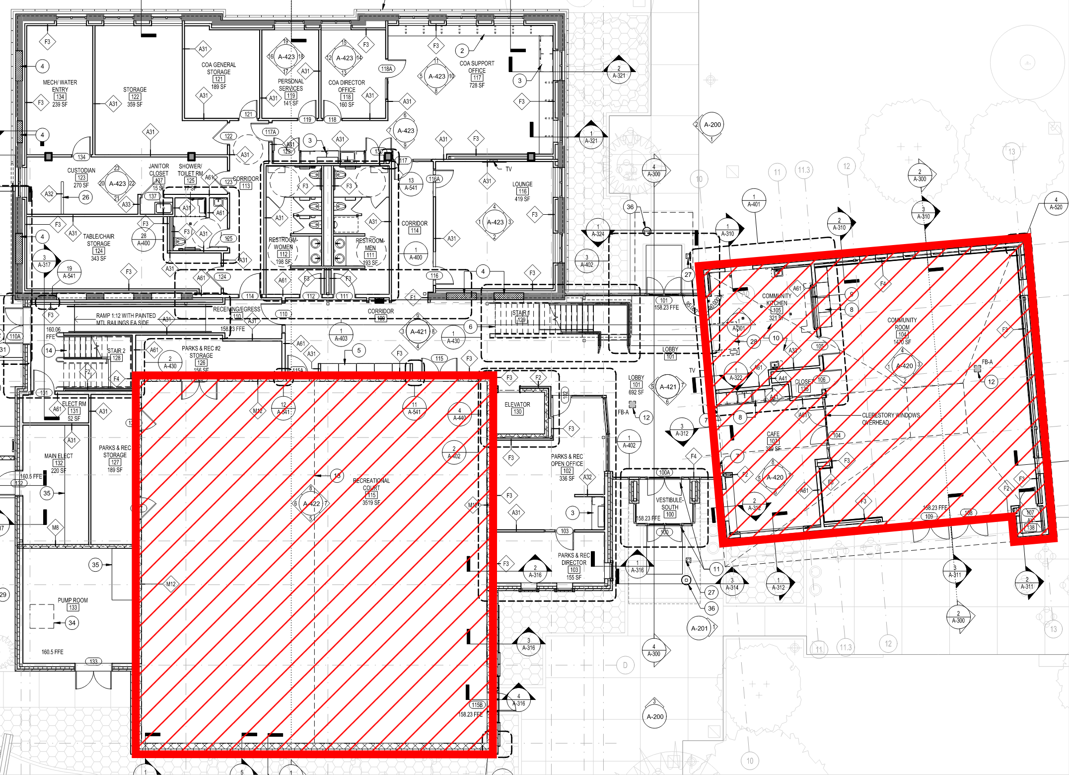
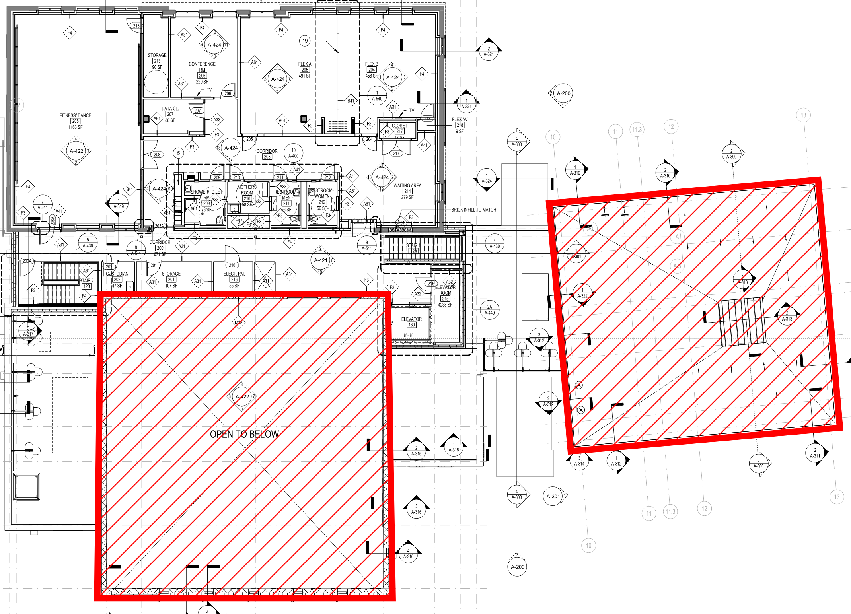
Option 3: Alter Existing Design to Expedite Re-Design Process
Reduction Analysis Targeting $11.85M
  First Floor Plan
  Second Floor Plan
  Floor Plan Reduction
  Removal of Community Room, Kitchen and Café = -2,535 GSF @ $550/SF = -$1.4M
  Removal of Recreational Court = -3,520 GSF @ $415/SF = -$1.46M
  Total Reduction = -6,055 GSF and -$2.86M
  New June 1st Bid = $14.02M | Escalated to Nov. 2023 = $15.5M
  OVERAGE = $3.8M (includes additional contingency)

Slide 10
Options 1, 2, and 3 Comparison
Option 1
NOV-DEC
JAN-FEB
MARCH
APRIL 2023 – MAY 2024
JUNE - JULY
Docs & Prequal
Bid
STM
Construction
Closeout
Additional Time = 5 Months
Additional Soft Costs = $300K+/-
*Doesn’t include additional construction costs or contingency*
Option 2
NOV 2022 – OCT 2023
NOV-DEC
JAN
FEB 2024 – MARCH 2025
APRIL - MAY
Design
Prequal
Bid
STM
Construction
Closeout
Additional Time = 15 Months
Additional Soft Costs = $1.7M+/-
$12.5M / $920/SF = 13,600 GSF Building Size (6,400 GSF less than current)
$11.65M / $920/SF = 12,660 GSF Building Size (Excludes Gym | 7,340 GSF less than current)
Option 3
APRIL 2023 – SEPT 23
OCT-NOV
DEC
JAN 2024 – FEB 2025
MARCH - APRIL
Design
Prequal
Bid
STM
Construction
Closeout
Additional Time = 9 Months (Not Including Option 1’s (5) Months
Additional Soft Costs = $1.5M+/-
Removal of Rec. Court, Community Room, Kitchen, and Cafe
Total Project Budget Overage = $3.8M+/-

Slide 11
Pembroke Community Center Analysis
  Bids Timeline
  DCC: June 1, 2022
  PCC: August 31, 2022
  Bid Amounts
  DCC: $16,887,700 ($830/SF @ 20,335 GSF)
  PCC: $17,977,000 ($646/SF @ 27,835 GSF)
  Project Scopes
  DCC: Add/Reno | Maintaining 9,000 SF 1910 Building
  PCC: New Construction | Existing 45,000 SF Building Demolished
  Bidder Coverage
  DCC: (3) GC Bidders | 14 Filed Sub Trades @ 3.7 bidders per
  PCC: (2) GC Bidders | 13 Filed Sub Trades @ 3 bidders per
  Filed Sub Bid Results
  DCC: $7,512,275 ($369/SF)
  PCC: $5,257,229 ($189/SF)
  Main Scope of Work Differences / Design Feature Discrepancies
  Exterior Cladding: Brick vs. Hardie Board | +140% | +$430K
  Roofing: 40% membrane vs. 9% membrane | no metal roofing on PCC | +80% | + $710K
  Windows: Metal (Filed Sub Bid) vs. Fiberglass (GC) | +80% | + $230K
  Fire Protection: Fire Pump System vs. Traditional | +550% | + $1.6M
  HVAC: ERV / VRF System vs. Heat Pump System | +50% | + $680K
  Kitchen Equipment: $190K add alt | +1.05% | + $190K
  Making Projects “Apples to Apples”
  Escalate DCC out to August 31, 2022 bid time = +$337,754 (+2%)
  Adjust PCC’s scopes of work / design features to align with DCC’s
  Results
  DCC: $17,225,454 ($847/SF)
  PCC: $22,690,678 ($815/SF)

Slide 12
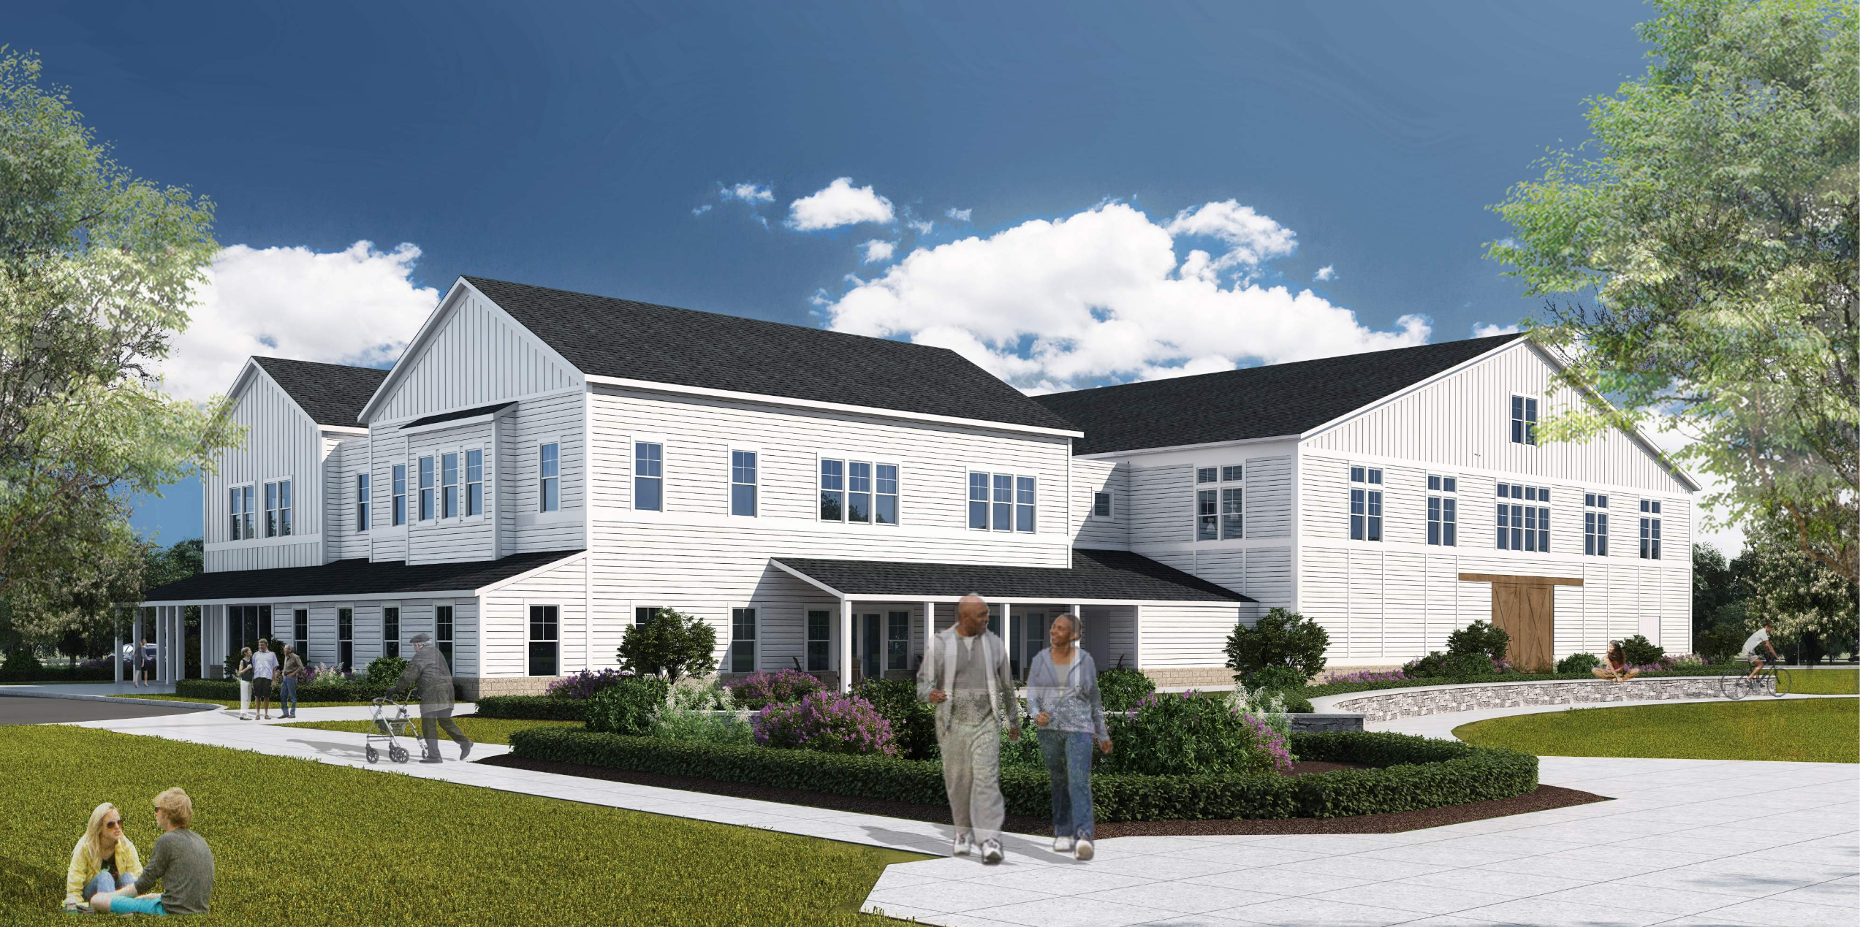
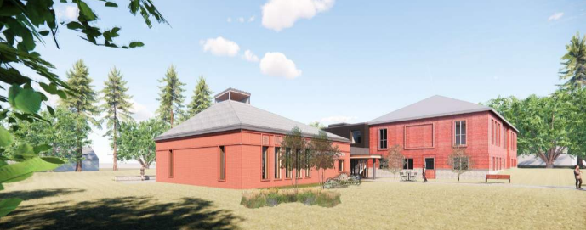
Pembroke Community Center Analysis
  Pembroke Community Center
  Dover Community Center

Slide 13
Design Peer Review
  Scope of Services
  Review cost estimate and architectural basis of design
  Review results of visioning sessions and building program
  Review activity schedule and room utilization schedule based on the design program
  Review Town’s anticipated staffing and operational plan
  Review anticipated occupancy levels for spaces and floors
  Review building and site layouts
  Review parking analysis
  Review specified building materials
  Review systems’ designs, i.e. Civil, Structural, MEP, etc.
  Compile report with findings and recommendations
  Fee
  Not to Exceed $7,500
  Timeframe
  3 – 4 weeks from notice to proceed

Slide 14
Discussion

Slide 15
Option 1: Re-Prequal & Re-Bid
Timeline (5 Months to Start of Construction) and Costs
NOV-DEC
JAN-FEB
MARCH
APRIL 2023 – MAY 2024
JUNE - JULY
Docs & Prequal
Bid
STM
Construction
Closeout
Construction Costs
$16,965,000 (Avg. June 1st Bid) + 5.16% (Feb. 2023 GC Bid) = $17,840,400
$17,840,400 - Current Const. Budget + Add’l Contingency = +$4,020,400**
Soft Costs
Designer, OPM, etc. = +$340K+
TOTAL: +$4,360,400+/-
*Assumes Project resumes November 1, 2022*
**Includes $360K additional contingency**

