Slide 1
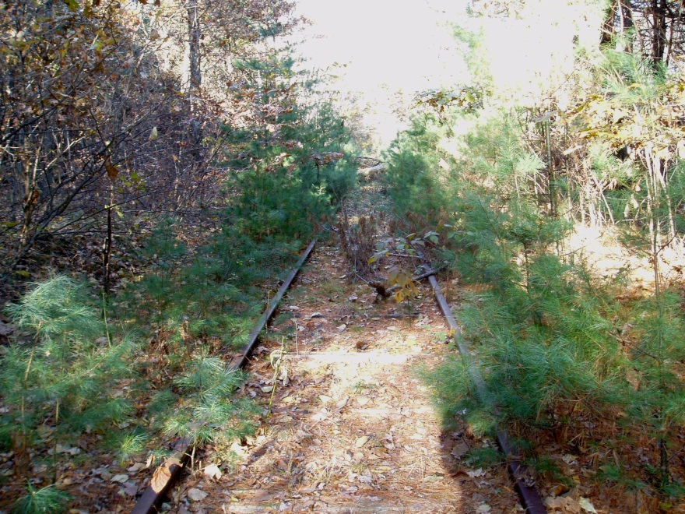
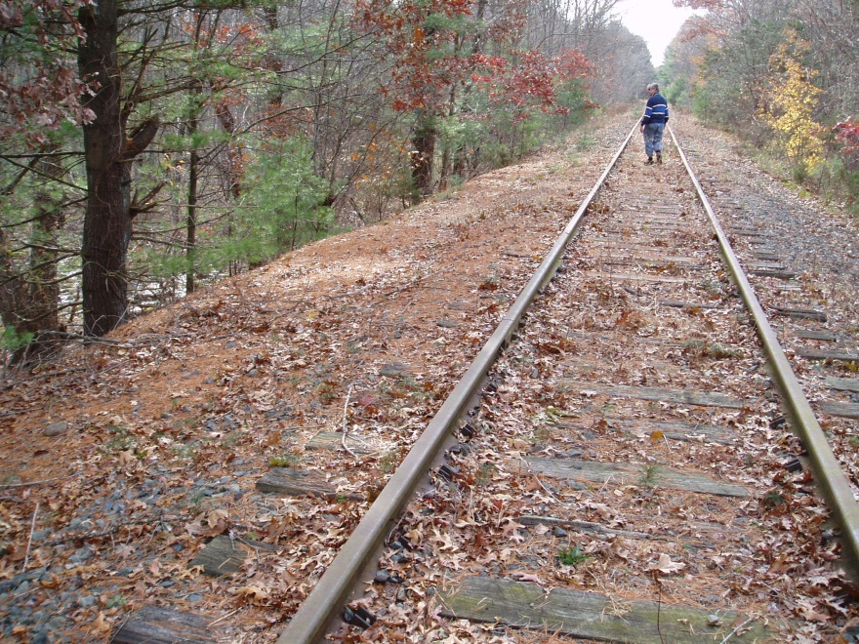
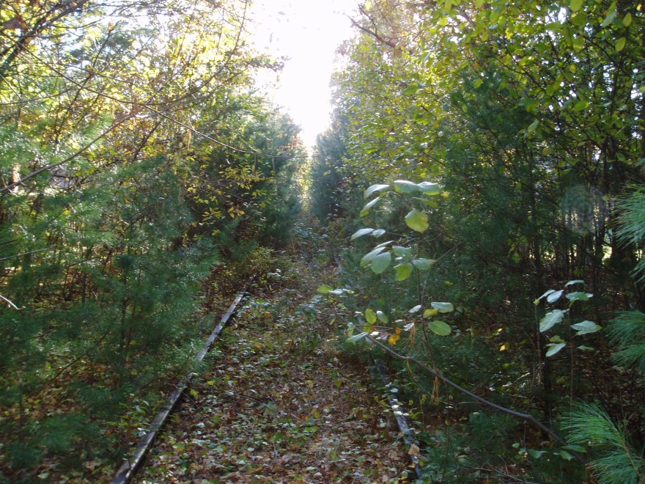
“Recreational Path Feasibility Study Update” Presented by Dover Rail Trail Committee Town Meeting, 5/6/13

Slide 2
Context
Opportunity to Convert the 3.7-Mile Unused Rail Corridor in Dover to a Recreational Path
Working Assumptions:
Preserve Town’s rural character
Appropriate for walking, running, casual bike riding, and skiing
Local control
Potentially strong value proposition (i.e., benefits relative to cost)
Dover Rail Trail Committee Working on a Feasibility Study to Understand Pros/Cons of the Path
Ad-hoc committee formed in 2011
At May 2012 Town Meeting, voters approved up to $5,000 for miscellaneous expenses related to the Feasibility Study

Slide 3
Feasibility Study – Key Questions
Is it feasible for Dover to convert the unused rail corridor into a Recreational Path?
Includes financial, environmental, legal, public safety, citizen interest, and community / abutter impact
If yes, then what are the Committee’s recommendations for the range of elements involved in creating the Path?
Considers what would be an appropriate Recreational Path for Dover and how it would be constructed, managed, and maintained
1
2
With the help of interested Dover citizens, the Committee identified over 80 items for review and study

Slide 4
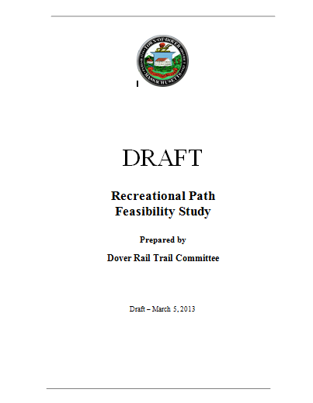
Status Update
Rail Trail Committee Activities
Status as of May 2013
Regular meetings with public attendance
Community engagement (open meetings, email list, web page, abutter mailings)
Engagement of Town officials (ConCom, Public Safety, etc.)
Research of other town activities and best practices
Knowledge sharing with Needham and Medfield on similar issues
Draft 30-page Feasibility Study, with some remaining questions and issues to explore
Available on Dover website since March

Slide 5
Key Feasibility Study Findings
1
Surface
Preserve rural character – NOT paved
2
Usage
Daytime walking, running, biking, skiing
3
Charles River Bridge
Excluded from Dover’s Path
4
Public Safety
Covered by existing Public Safety resources
5
Sufficient public parking capacity exists
Parking
6
Friends Group
Will help with funding and maintenance
7
Standing committee to provide oversight
Governance

Slide 6
Warrant Article Request
Five Key Items Require Additional Research and Professional Expertise
1
Right-of-Way Review
Warrant Article requests $50,000 to fund sufficient due diligence on these key items, i.e., commissioning targeted external professional services
If approved, the Committee will work toward completion of the Feasibility Study in time for the May 2014 Town Meeting, as appropriate
2
MBTA Lease Terms
3
Engineering Analysis
4
Construction Parameters
5
Environmental Review

