Slide 1

Green Communities Designation and Grant Program
Administered by Mass Dept. of Energy Resources
Substantial grants for energy efficiency projects
155 cities and towns already certified
Sherborn certified in 2011, has received ~$200,000
Zoning and bylaw changes will require Town Meeting approval

Slide 2
Article 14: Stretch Building Code
Optional appendix to State building code
Cost-effective route to energy efficiency
Performance-based measurements
Not significantly stricter than current base code, per Town Building Inspector

Slide 3
Article 15: Zoning for Solar Array
Designate possible location for solar array
Old landfill next to the Transfer Station
Area is already cleared and accessible
Town only required to zone for array; no requirement to build; no spending

Slide 4
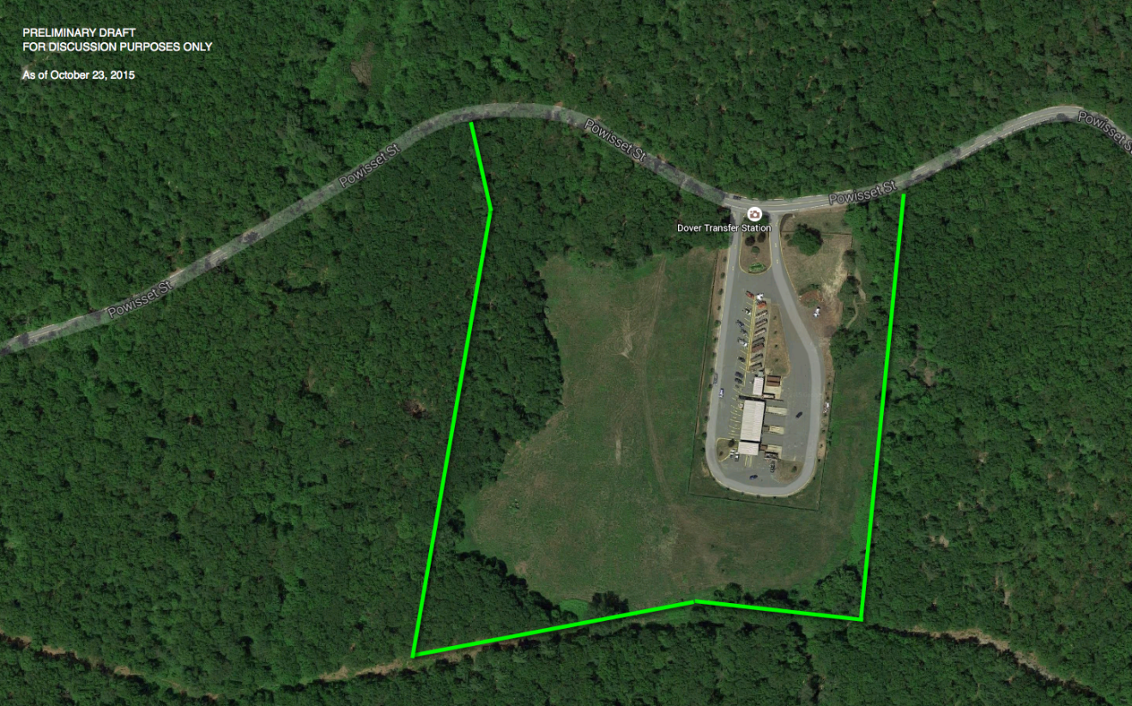
Article 15: Proposed Location

Slide 5
Grants for Energy Efficiency
Sherborn
2011: $137,450 for boiler conversion, lighting upgrades, weather sealing, and more
2015: $77,800 for Pine Hill School HVAC upgrades
Weston
2011: $136,675 for boiler replacement
2014: $243,707 for energy conservation at schools & fire dept.
Dover
FY2018: Cooling temperature controls at Chickering School
FY2018: Boilers, pipes, and controls at Caryl Community Center

