Slide 1

Article 15: Solar PV Overlay District
Planning Board
Annual Town Meeting
May 2, 2016

Slide 2
Why create a Solar PV Overlay District?
The Selectmen asked the Planning Board and LRPC to evaluate the benefits of becoming a designated Green Community
As discussed in the context of Article 14 (Stretch Code)
To be a Green Community, Dover must allow as-of-right siting for a renewable or alternative energy facility
We propose to do this by creating a zoning area at/around the Transfer Station where a solar PV array would be allowed

Slide 3
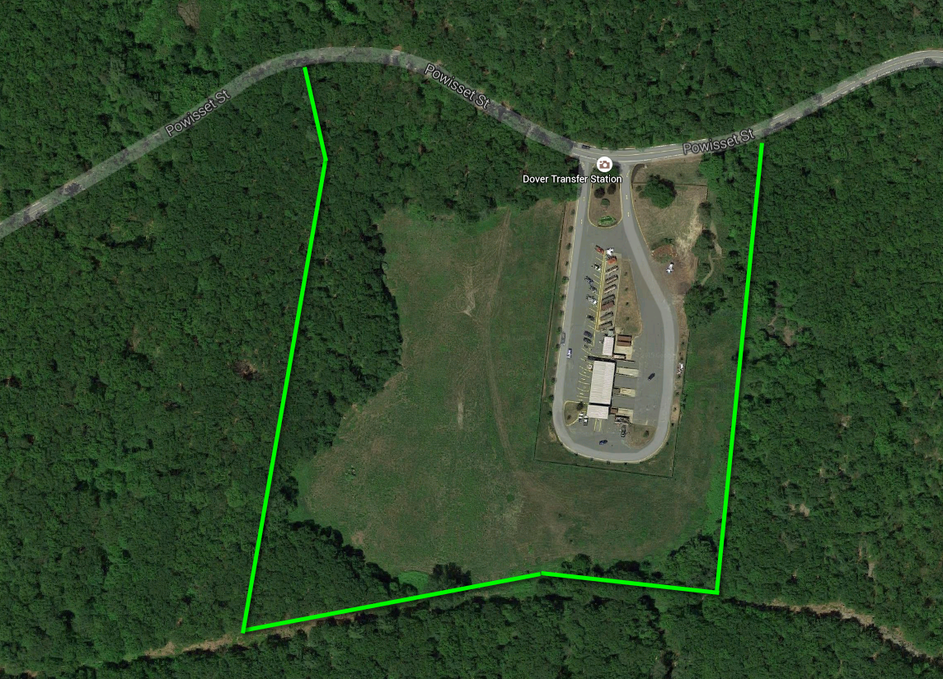
The proposed Solar PV Overlay District

Slide 4
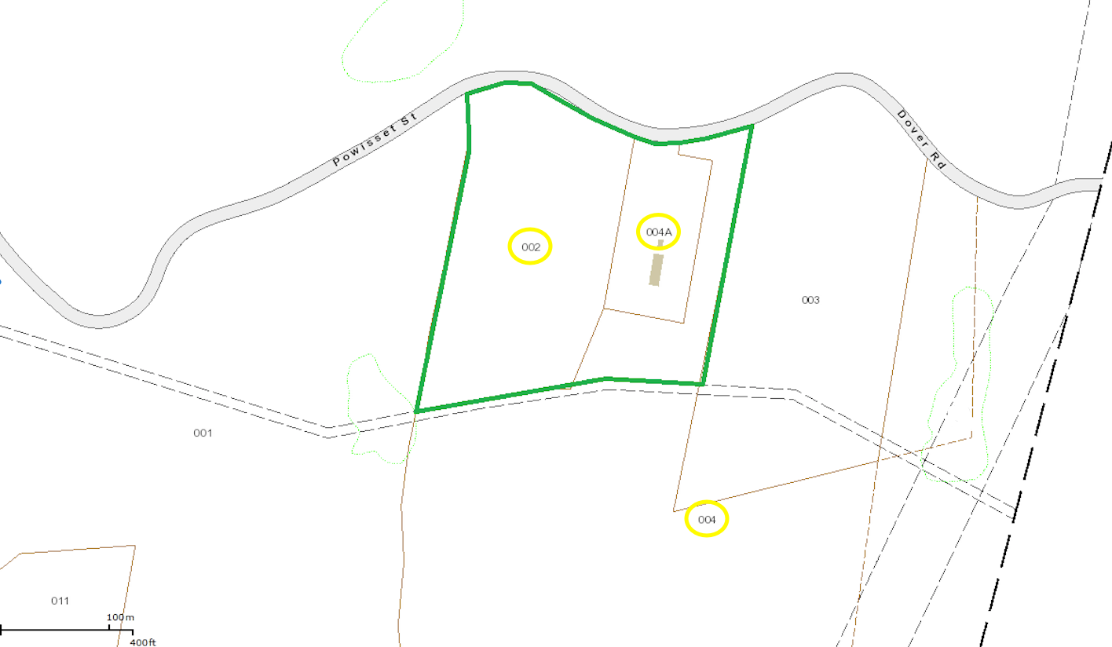
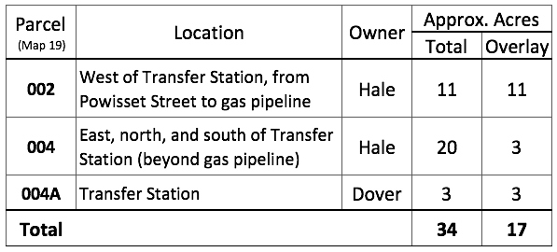
The proposed Solar PV Overlay District
This area is comprised of all of two parcels and part of a third:

Slide 5
Why this location?
This location has no close abutters
This location has plenty of space for a 250 kW solar array without any clearing of trees or other disturbances
250 kW requires only roughly one acre of land
A solar array on Parcel 002 (west of the Transfer Station) likely would not be visible at all from Powisset Street
The capped landfill at Parcel 002 is not suitable for other uses
These parcels are close to high-voltage electric transmission lines to the east for easy access to the electrical grid
Notes:
Could amend the bylaw later if other locations also would be desirable in the future

Slide 6
What does creating this overlay district mean?
Dover would meet the first two criteria for Green Community status (by-right renewable zoning and expedited review)
Eligibility for significant grants ($140,000+ upon designation)
It does not mean a solar array has to be built; a project might never be proposed and would not involve the Town
Just having the zoning in place satisfies Green Community criteria
Any proposed project would have to go through the Site Plan Review process
Notes:
Expedited review = 12 months
Can be extended by mutual consent

