Slide 1
Article 17- 46 Springdale Warrant Committee Minority Opinion Rationale of Recommendation to Vote No on Article 17

Slide 2
Article 17- 46 Springdale Minority Opinion
It is not clear that alternative disposition scenarios which could achieve the Town’s goals, perhaps, at a lower ultimate cost, have been explored and given their due consideration.
Accordingly, approving Article 17 may not be in the best financial interests of the Town.

Slide 3
Article 17- 46 Springdale Minority Opinion
Background
At the Special Town Meeting September 15, 2014, the Board of Selectmen were authorized by greater than a 2/3 vote to acquire for $5.55 million the 27.2 acre property at 46 Springdale to prevent a threatened 40-B development of the property.
At that same meeting the Town authorized the funding of an ad-hoc committee, the Springdale Study Committee (SSC), to study the possible uses for the property.

Slide 4
Article 17- 46 Springdale Minority Opinion
Background
The SSC considered a very broad range of options for the use and disposition of the property.
The SSC conducted a comprehensive survey of townspeople (510 responses) for opinions about potential uses.
A main conclusion of the survey was that “preservation of open space is highly valued.” (46Springdale-proposal-for-future-use-.pptx, slide 5)

Slide 5
Article 17- 46 Springdale Minority Opinion
Background
Although the answers to the several questions are subject to interpretation a clear preference for “open space and passive recreational use” was the mode.
The Board of Selectmen has put forward Article 17, which divides the property and provides for the offering for sale of the House Lot.

Slide 6
Article 17- 46 Springdale Minority Opinion
The Article 17 proposal
to split-off and sell 4.7 acres including the house, barn & paddock (House Lot)
repairing the failed septic system for $50,000
and for the Town to retain the remaining 23.5 acres for “general municipal use”
has been suggested could return to the Town $1.5- $2.0 million of the $5.55 million purchase price upon the sale.

Slide 7
Article 17- 46 Springdale Minority Opinion
Issues to Consider Relative to Article 17
It appears only one scenario (4.7/23.5 acre division) has been seriously considered. An in-depth analysis of the alternative disposition scenarios should be undertaken with the goal to have a proposal for ATM 17.
The parcel may not achieve the price that has been discussed as ($1.5-2.0m) due to:
Uncertainty about the Town's plans for the back parcel
Complexities of the required governmental sale process for the parcel.

Slide 8
Article 17- 46 Springdale Minority Opinion
Alternatives
Alternatives which would be consistent with the Town's stated preferences for 46 Springdale and also may provide a more attractive cost to the Town should be explored.

Slide 9
Article 17- 46 Springdale Minority Opinion
Alternatives
Alternatives could include one or a combination of:
1) Disposition of more of the property with the House Lot, while retaining the majority of the land as stated as a preference in the survey
2) Establishing Conservation Restrictions (CR) on the land to preserve the open space
3) Establishing an Easement allowing public access to sections of the property

Slide 10
Article 17- 46 Springdale Minority Opinion
Alternatives
There are many other ways to configure the House Lot that may bring a higher sale value.
Additional division/configuration scenarios may include the following:

Slide 11
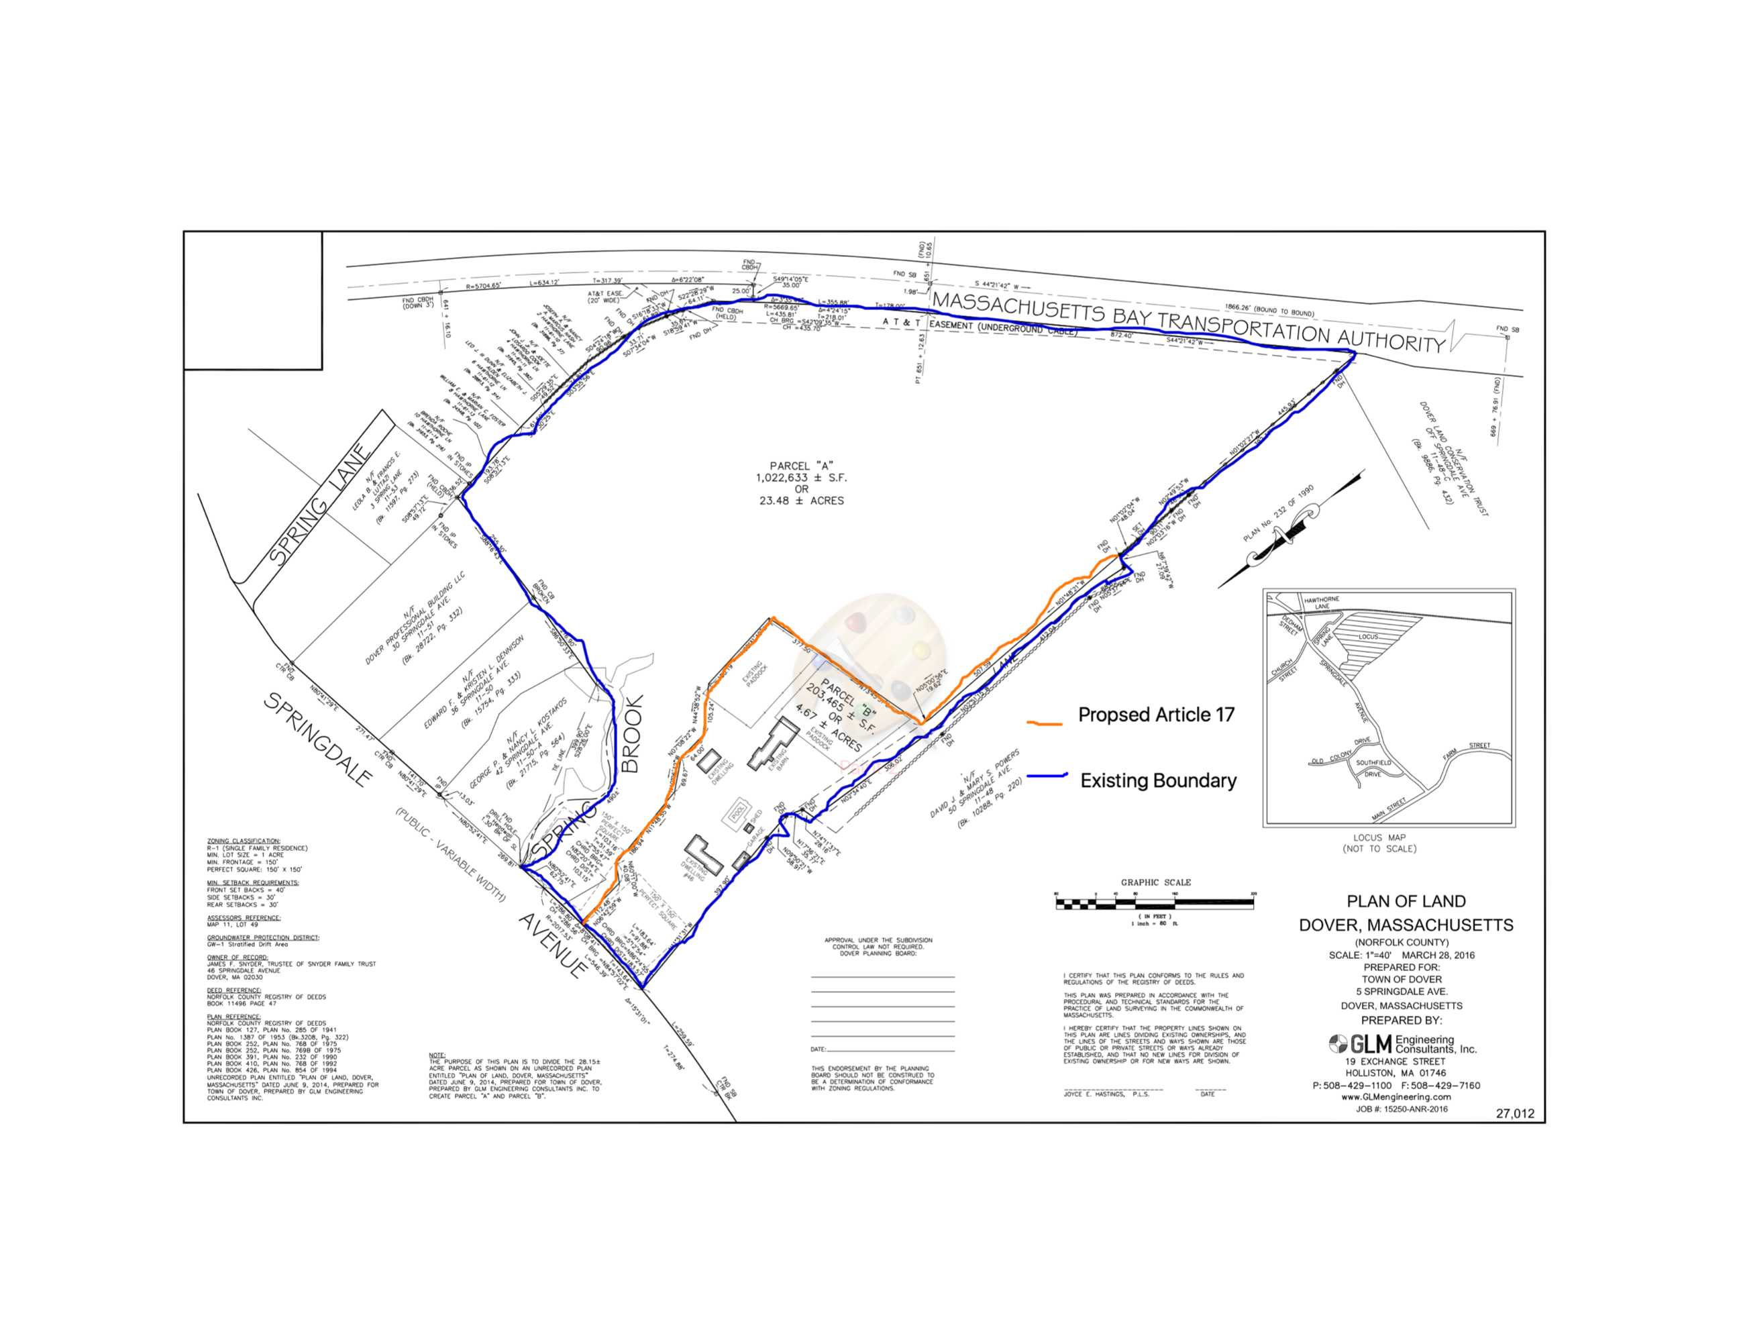
Article 17- 46 Springdale Minority Opinion

Slide 12
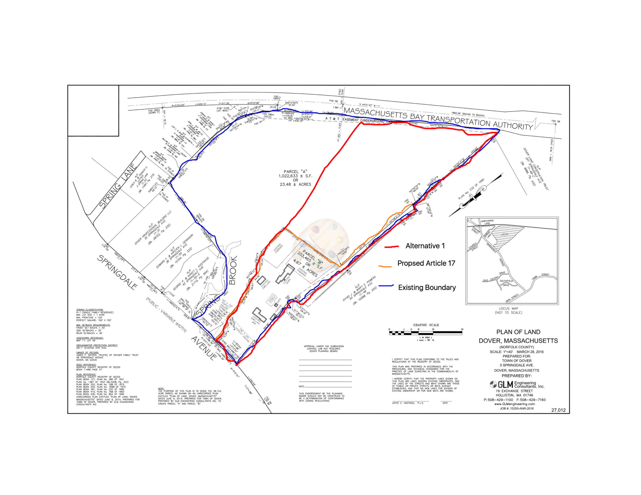
Article 17- 46 Springdale Minority Opinion

Slide 13
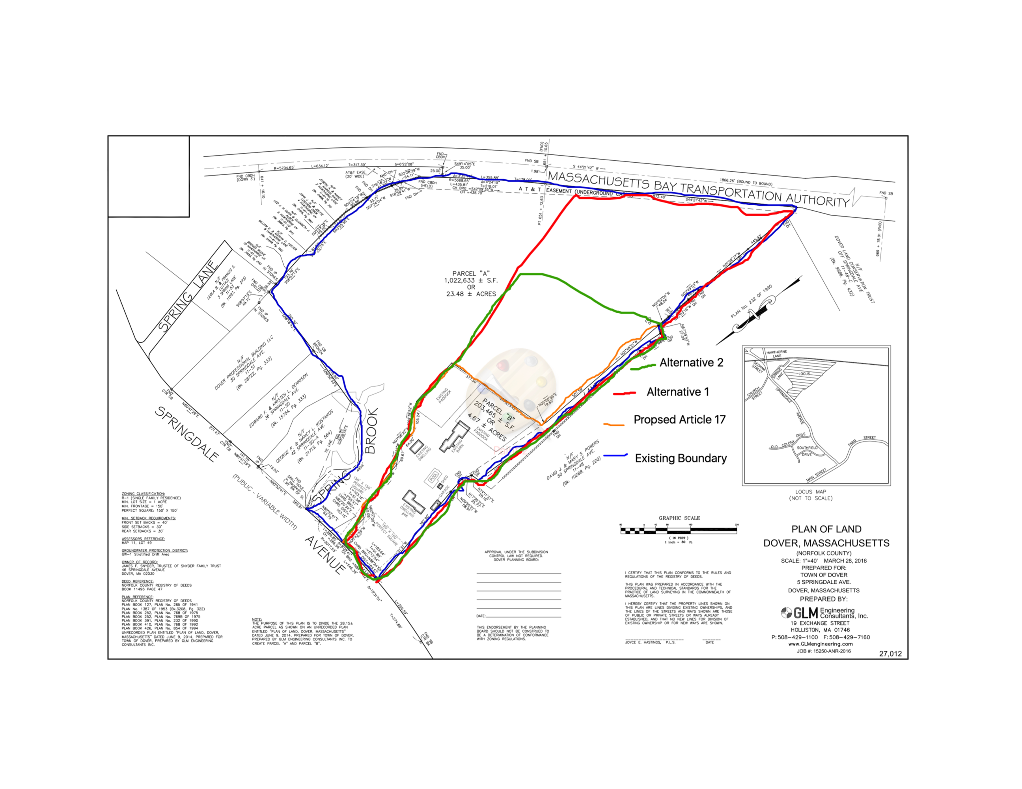
Article 17- 46 Springdale Minority Opinion

Slide 14
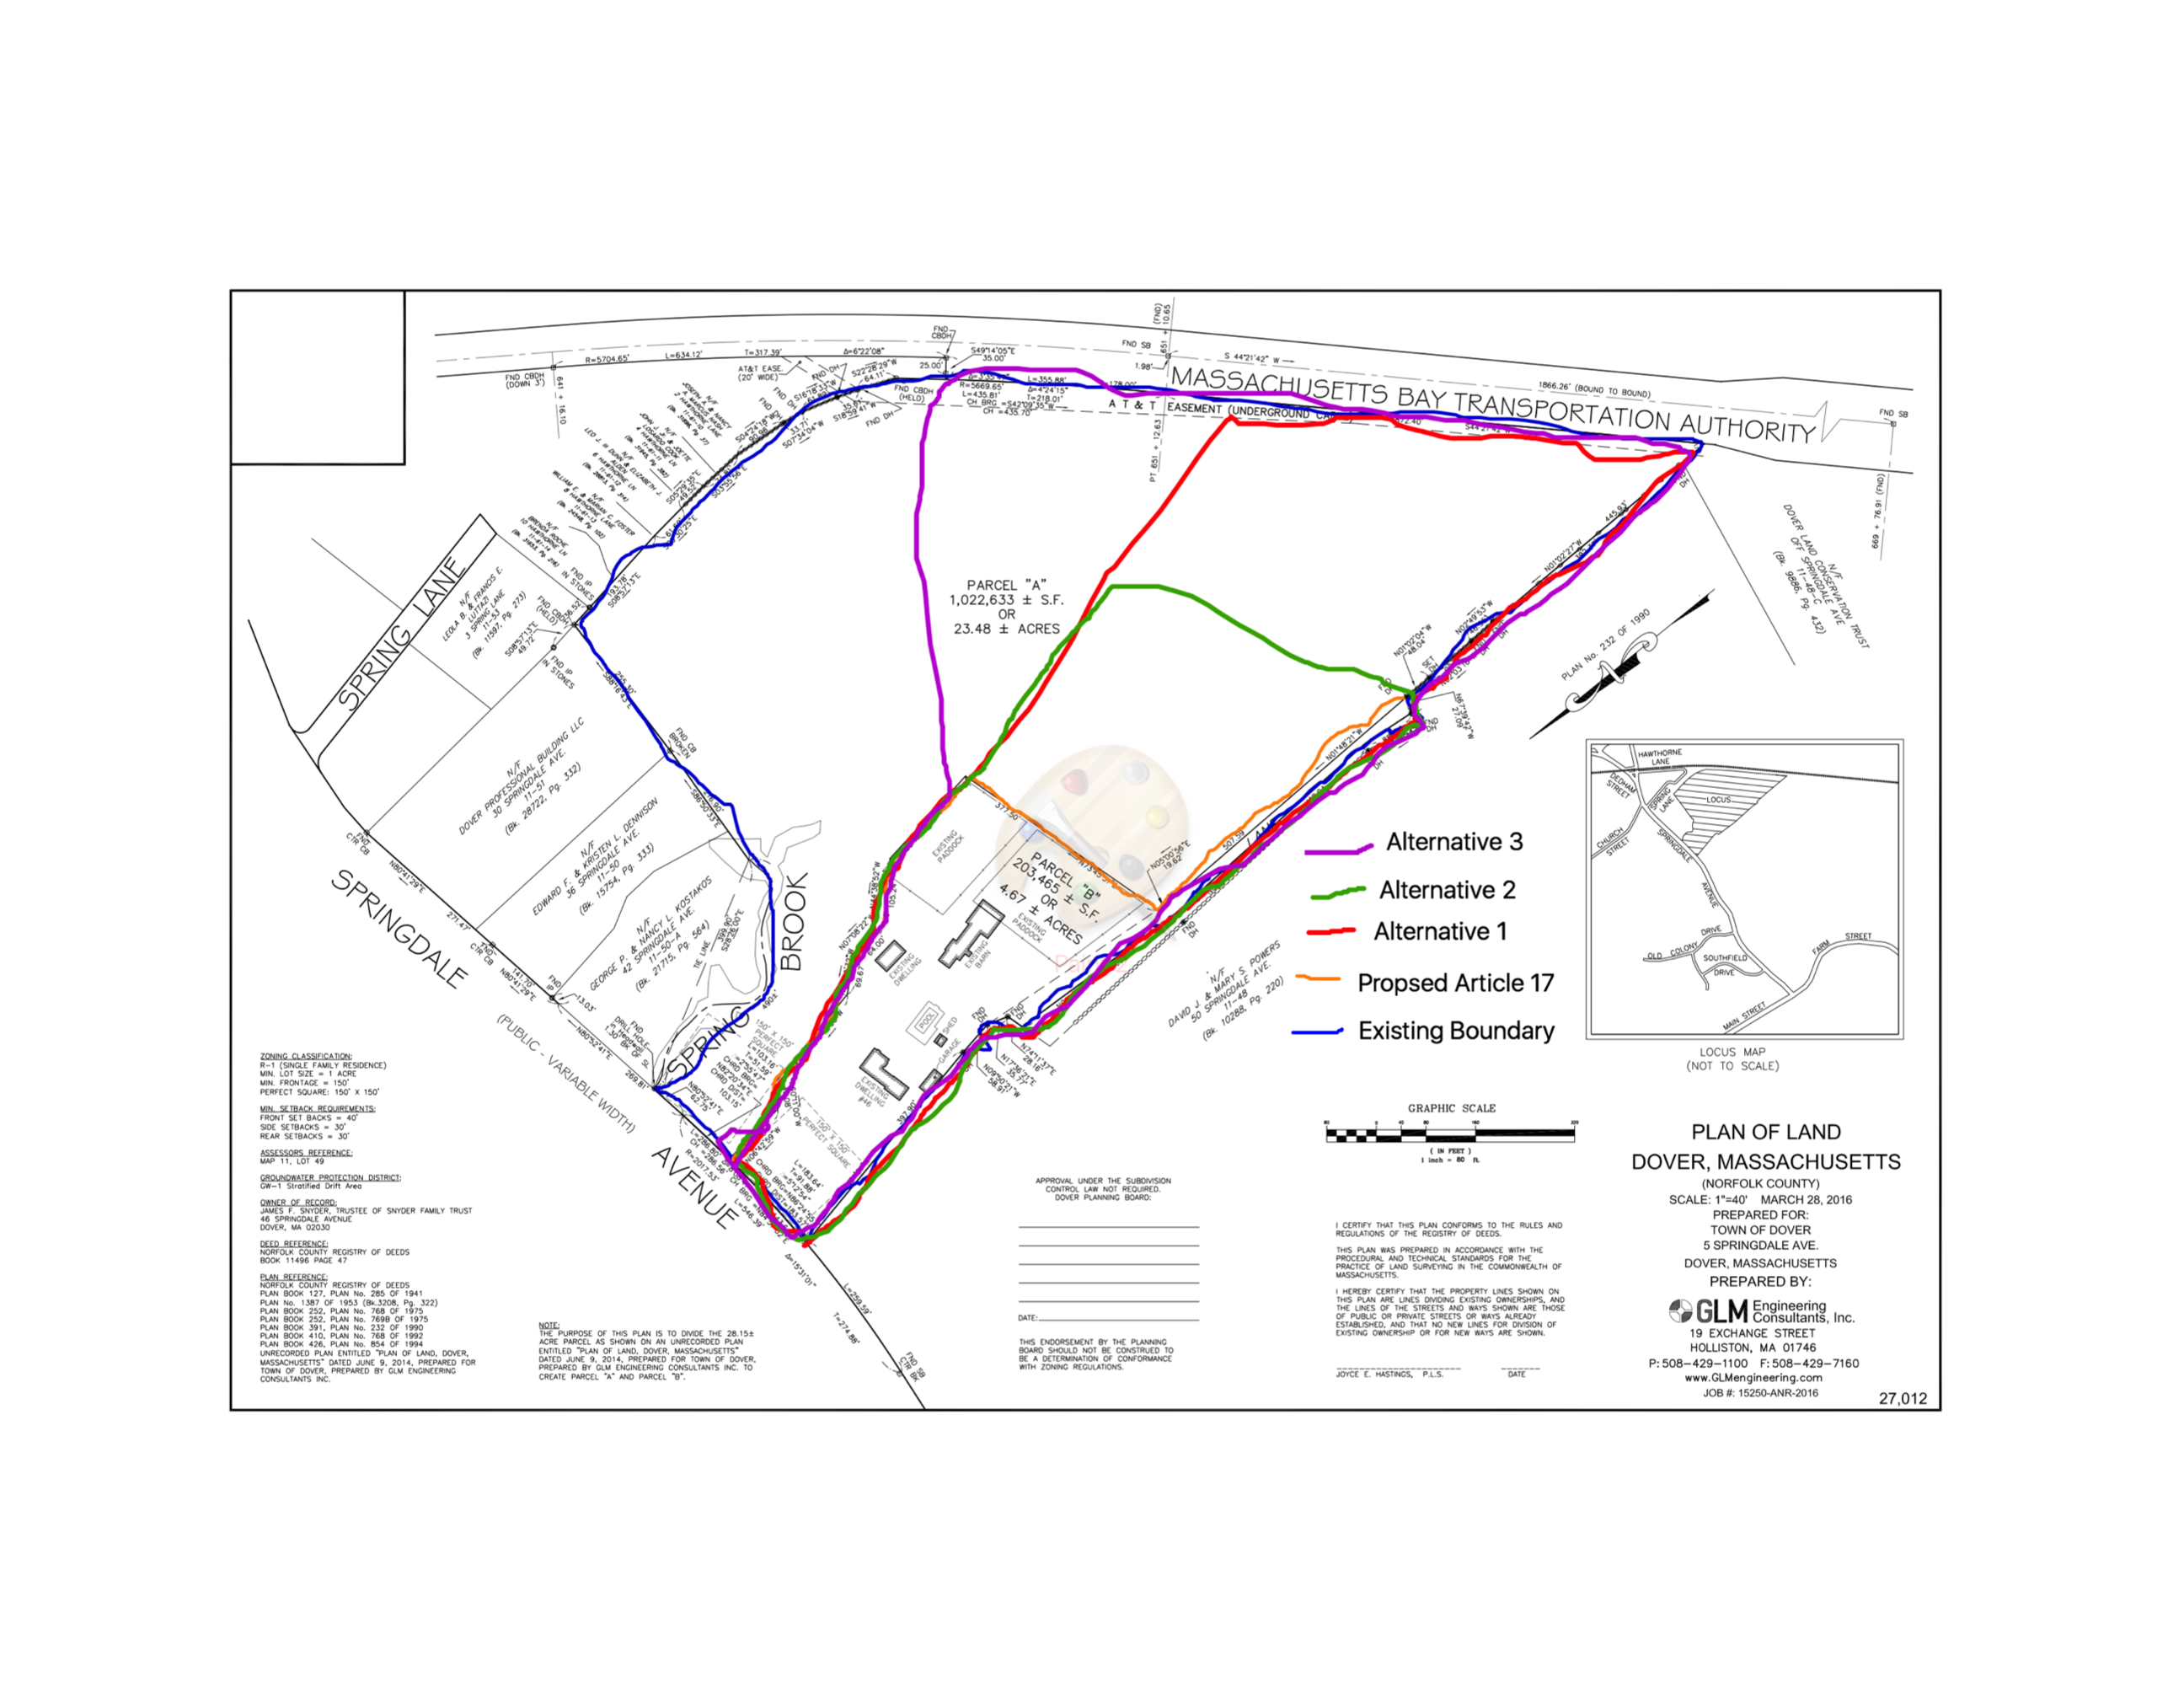
Article 17- 46 Springdale Minority Opinion

Slide 15
Article 17- 46 Springdale Minority Opinion
Alternatives
Conservation Restrictions
CR could be put on part of additional acreage to be sold potentially increasing the attractiveness to a buyer of the House Plot while still keeping the back land open.

Slide 16
Article 17- 46 Springdale Minority Opinion
Alternatives
Easements
Easements could be used to allow access and the objectives of passive recreation with out the Town’s retaining ownership of such large portion of the land.

Slide 17
Article 17- 46 Springdale Minority Opinion
Conclusion
If the Town approves Article 17, and a sale goes through, we would lose control of the entire parcel for which we paid a premium.
It would seem prudent to not rush and rather hold off on a sale until a thorough analysis of the alternatives has been considered.

Slide 18
Article 17- 46 Springdale Minority Opinion
Thank you
End of Presentation

Slide 19
Article 17- 46 Springdale Minority Opinion
Appendix Slides

Slide 20
Springdale Survey
Q8: Dover currently has less than 1% of its housing units considered to be affordable, which is less than all surrounding communities, and well below the 10% required by state statute. As a result, Dover is vulnerable to unfriendly 40B development, and will remain vulnerable until the Town addresses this important concern. Please indicate your level of interest in the following types of residential development at 46 Springdale Avenue:

Slide 21
Springdale Survey
Q9: Please indicate your level of interest in the following scenarios as they relate to offsetting the $5.5 million purchase price of the property. As an example, if the Town recouped $2 million and financed $3.5 million at today's rates, the median property tax bill would increase 1-2% per year (debt service scenarios are detailed here: http://www.doverma.org/wp-content/uploads/2014/04/Debt-Service-Schedules-EP-6-20-14-61A.pdf).

Slide 22
