Slide 1
Dover Town Meeting
May 2, 2016

Slide 2
Article 18: The Motion
authorize the Board of Selectmen to acquire a leasehold interest in the railroad line within the Town of Dover
I move that the Town vote to authorize the Board of Selectmen, on such terms and conditions as the Board of Selectmen deem appropriate, to acquire a leasehold interest in, on, over, across, under and along all or any portion of the land known as Bay Colony railroad line or right of way within the Town of Dover excluding the portion of the Bay Colony railroad line that includes any bridge, trestle or supporting structure that spans the Charles River, for the purposes of establishing, constructing, operating and maintaining a multi-use path for non-motorized transportation, open space and recreation purposes and for all other purposes for which rail trails are now or hereafter may be used in the Commonwealth(“Rail Trail”); provided, however, that the Board of Selectmen shall not enter into any such lease until the Town has (1) received at least $50,000, in the forms of gifts or grant monies, to obtain environmental insurance that would satisfy the coverage requirements necessary to enable the Town to avail itself of the protections of Massachusetts General Laws Chapter 23A, Section 3I; and (2) negotiated a lease that permits the Town to limit development of the Rail Trail to that portion of the Rail Trail extending south of Springdale Avenue.
excluding the bridge that spans the Charles River
AND ensuring that the lease will permit development of only the portion south of Springdale Ave
but NOT before
receiving funding for the environmental insurance policy

Slide 3
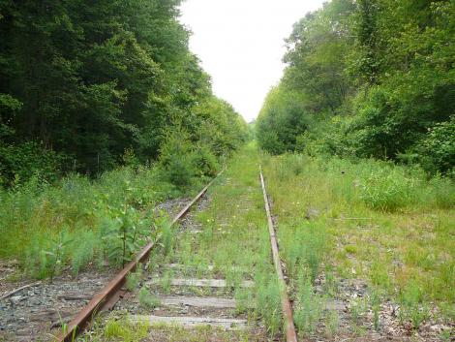
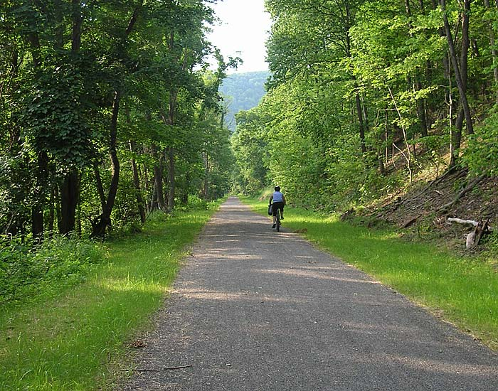
The Dover Greenway Vision

Slide 4
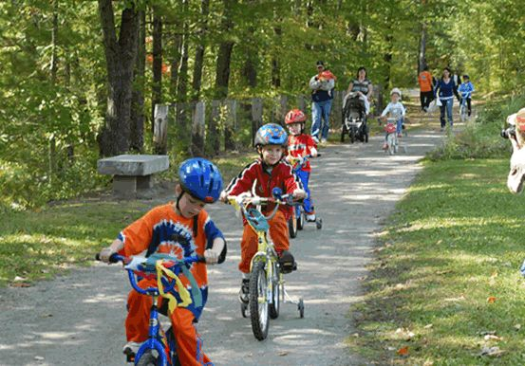
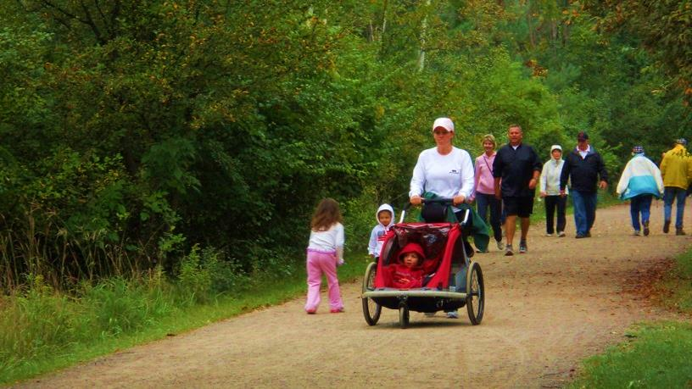
Greenway Details
Lease the MBTA’s unused land for 99 years for $1/year
Convert it into a 2.7 mile, flat, ADA-compliant path
Stone-dust surface for walking, biking, jogging and skiing
Start at Springdale Ave and extend to Hunt Drive
Protect 7 acres of land for Dover’s benefit

Slide 5
Yes Vote Lets Selectmen Take Over
Yes vote tonight ➔ Selectmen negotiate lease with MBTA
Selectmen may bring final lease back to Town Meeting before signing
Friends and Selectmen agree to fundraising goals for lease signing, breaking ground, etc.
Selectmen determine Greenway governance structure
Recommendation provided in Dover Rail Trail Committee report

Slide 6
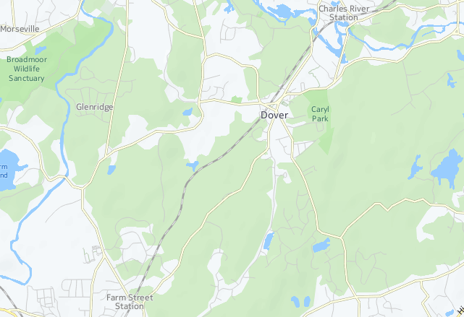
Limit Development to a Dover Trail
Undeveloped Zone
Convert Trail
Undeveloped Zone
Notes:
This vision is most sincere expression of Friends desire to implement trail in a respectful way that works for the Town

Slide 7
Protections for Dover Residents
No request for Town funds (FDG will gift to Town)
Limits usage volume by restricting scope of trail
Prevents loss of land to other potential lessees
Removes rotting, contaminated ties / caps rail bed
Significant protections to Dover for environmental liability
Did you know…….
There are over 60 rail trails just in MA and an additional 68 projects in progress totaling 300 miles of rail trails.
www.railstotrails.org/our-work/united-states/massachusetts/

Slide 8
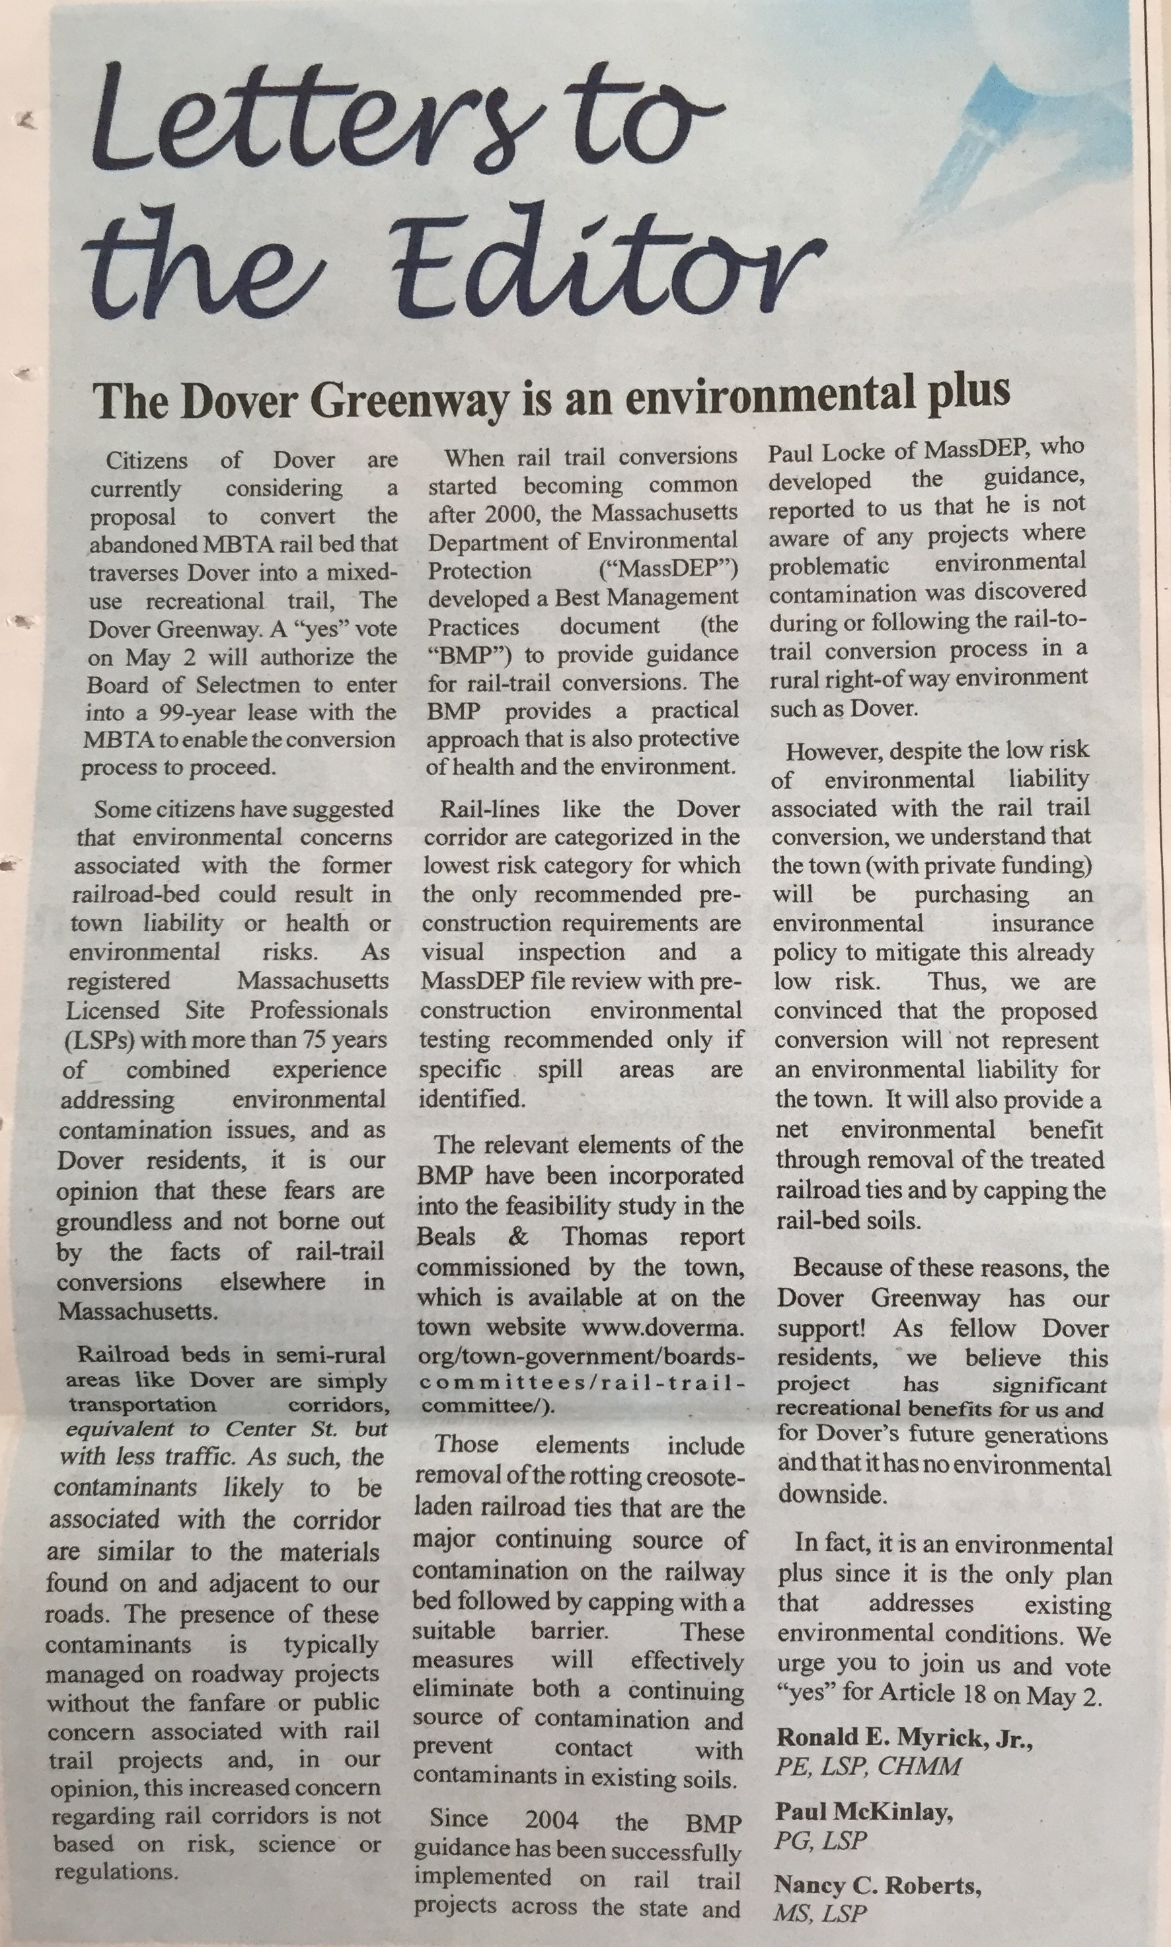
Environmental Improvement
Licensed Site Professionals Letter
Each LSP resides in Dover
“Environmental Plus”
MA Department of Environmental Protection
Thomas Mahin and James Persky, Drinking Water regional contacts*
Environmental conditions would improve with rail trail
Colonial Water
Phone conversation with Alan Melancon, November 17, 2015*
No history of water quality concerns
*Appendix VIII, page 85 Beals & Thomas Dover Feasibility Study 12-15-15
Notes:
Very low environmental risk and improvement to environmental conditions – recommend against soil testing
Environmental conditions would be improved with rail trail implementation
no water quality concerns at this well even with the prior history of railroad use.

Slide 9
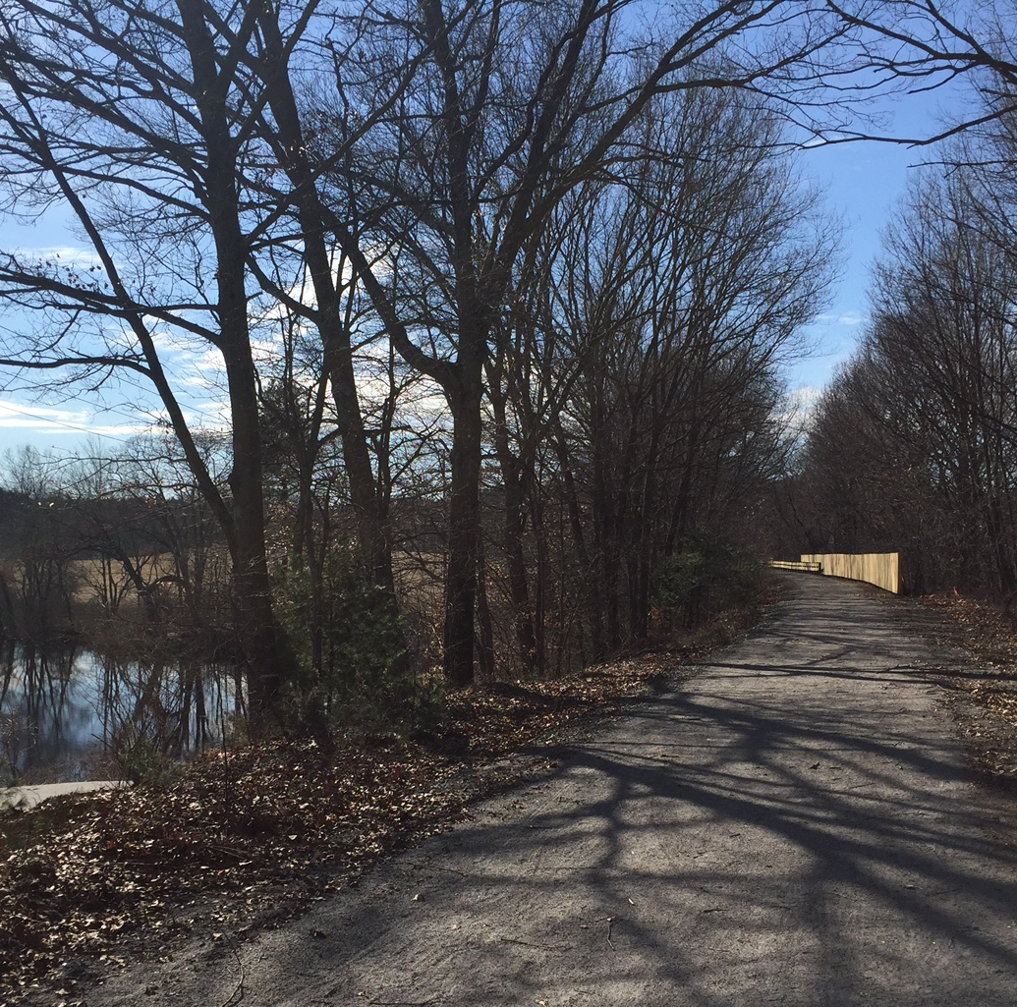
A Trail for Everyone
Respect all constituencies in trail design and planning
Low-maintenance, rural trail
Privacy screening
Retain horse trail crossings, protect with signage
No impact on annual hunt
Sensible waste management
Safety, home values and crime data benefit all

Slide 10
Costs, Maintenance and Parking
Costs
Beals & Thomas estimate: $1,124,600 including environmental insurance*
Limited development should reduce costs
Maintenance of the trail
$40,000 maintenance escrow in estimate (10 years projected expense)
Friends of Dover Greenway will coordinate volunteer trail maintenance
The Highway Department will continue to maintain road crossings*
Parking
There are currently 155 parking spots available in Dover center**
Friends estimate that 20 spaces will typically be needed on weekends
Additional parking option: Channing Pond with access through 46 Springdale
*Beals & Thomas, Feasibility Study Dover Recreational Path, Dover, MA December 17, 2015
**Recreational Path Feasibility Study prepared by Dover Rail Trail Committee, Final Report – Spring 2014

Slide 11
Reasonable Usage Projected
Milford
pop. 25,000
Holliston
pop. 14,000
= 2,500 Upper Charles trail users
on one of the busiest days of the year
(5.7 mile trail, 200 users per hour)
Dover
pop. 6,000
~200 trail users/day
on weekend days in May
60 users per day on weekdays
10-40 users per day in winter
(3 mile trail, 12 users per hour)
References:
http://milfordtrail.org/2012trailcensus.html
Calculation – 1 user per 33 residents within 2 miles of trail
Salem – Concord Bikeway Demand Estimate, Alta Planning + Design

Slide 12
If We Vote “NO” Tonight…
Persistent safety concerns for walkers/kids on Dover’s roads
Continued limited outdoor recreation opportunities for residents who are disabled or have unsteady gaits
Loss of control of the corridor:
Weston
Sudbury
Missed opportunity to have a recreational resource accessible by all of Dover
“55 percent of trail users exercising more now than before they had access to the trail”*
*Ross C. Brownson, “Promoting and Evaluating Walking Trails in Rural
Missouri,” Saint Louis University School of Public Health, 1999

Slide 13
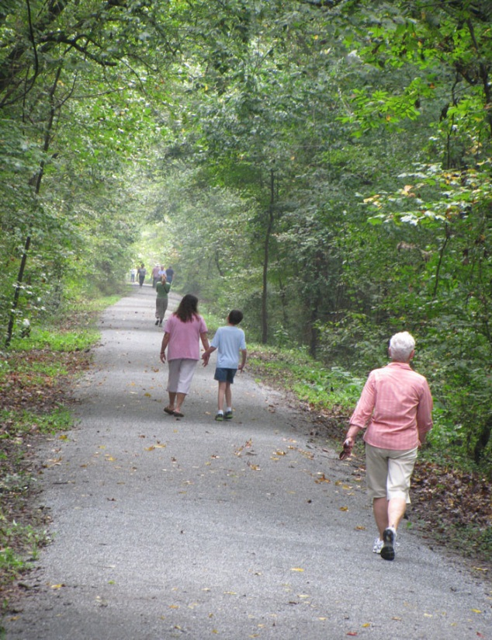
Benefits for all Dover Residents
Improve public safety, expand resources
Safer in-town connections & recreation
Only ADA-accessible path allowing recreation for all
Environmental safeguard
Dover control of corridor
Leverage town use
Economic value
Greater sense of community
Connect people, places, past history
Be Part of a Legacy for Dover

Slide 14
Thank you.
Please vote “YES” on Article 18

