Slide 1
Caryl Community Center
Article 11 – Critical Maintenance
Boiler Replacement
$600,000

Slide 2
Some Facts About the Caryl CC
Town-owned asset; Selectmen’s responsibility to maintain it
Total 41,000 sf: 30,000 sf usable program space; 11,000 sf hallways, stairways, bathrooms, & mechanical spaces
Home to Council on Aging and Parks & Recreation and…
Four licensees providing services needed/desired by Dover residents
Room for anticipated municipal office expansion
Steady increase in program participants, from 0 in 2002 to 20,000 in 2018

Slide 3
Maintenance at the Caryl CC
Minor – Funded through both operating and capital budgets:
Painting, wall & floor repairs; installation of new carpeting, water coolers, signage, and AC in selected areas; parking lot paving
Major – Funded through special articles voted at Town Meetings:
New roof (2007, 2008)
Structural and masonry repairs to stabilize & seal building (2009)
Replacement of underground oil tanks (2011)
Full renovation of four (4) public bathrooms (2015)

Slide 4
Next Up: Boiler Replacement
Problem: At almost 90 years old, our boilers have…
-- Lasted more than twice their projected lifespan
-- Broken down frequently in recent years
-- Become more costly to maintain & obtain replacement parts
Needed: A long-term, reliable, efficient, cost-saving heat source
Anticipated:
-- Capital budget planning list since 2013
-- Presented in 2015 as next project after bathroom renovation
NO BOILERS = NO HEAT = NO PROGRAMS = NO CCC

Slide 5
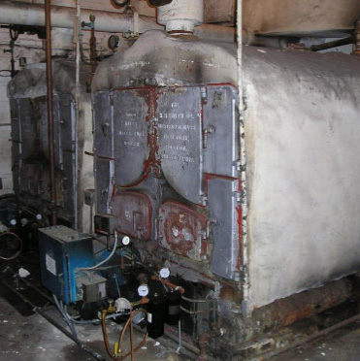
More About Boilers
Planning: Four years for this project
-- Boilers on capital planning list 2013
-- HVAC Boiler & Systems Eval. 2014
-- Accessibility Study 2016
-- HVAC Peer Review 2017
--Study for Required Improvements 2017
Questions:
-- How many boilers?
-- What type of fuel?
-- Did we miss Green Community grant deadline?
Insert photo of boiler from Forte Engineering 2014 HVAC study, page 17: boiler left

Slide 6
Cost
$600,000 – Funded through use of Free Cash – no tax impact
Project cost breakdown:
-- Construction cost, incl. escalation (4%/yr) $428,742
-- Construction contingency 34,299
-- Hazardous materials allowance (asbestos) 35,000
-- Architect/engineering allowance 45,000
-- Owners project expenses 10,000
-- Conceptual project cost $553,041
Rounded $600,000
Cost drivers: State requirements & cost escalation

Slide 7
Why Support Article 11?
Keep Caryl open – boilers mission critical!
The need anticipated & planned for
Use grows with improvements made
Time to finish the job we began in 2003!
NO BOILERS = NO HEAT = NO PROGRAMS = NO CCC

Slide 8
