Slide 1
Dover Board of Health Water Resources Study Committee
Presentation to Dover Town Meeting
May 7, 2018

Slide 2
Members of the Water Resources Study Committee
Gerald Clarke, Chair of WRSC and Board of Health
Justine Kent-Uritam, Member of Open Space Committee
Carol Lisbon, Member of Planning Board
Ron Myrick, PE, Massachusetts Licensed Site Professional
Greg Kahoun, Member of Open Space Committee
Carol Chirico, Member of Planning Board

Slide 3
About the Water Resource Study Committee (the Committee)
Established by Board of Selectman under the authority of the Board of Health
Since our first meeting last summer, the Committee has:
Obtained and reviewed existing data and public reports and determined what data is needed to gain understanding of groundwater status
Met with elected officials and state regulators
Attended hearings of the MA Department of Environmental Protection (DEP)
Developed a proposal for a hydrology study
At this time the Committee has three major goals:
Collect data on Dover’s groundwater resources
Obtain a professional analysis by commissioning a hydrology study
Be a source for information on Dover’s water quality and quantity, with the understanding that availability of water is critical to property values and the ability to transfer real estate

Slide 4
Why we Should be Concerned about Water Resources in Dover?
In the past 2 years, at least ten residential wells have failed, and deeper wells are required to gain necessary flows
Evidence of perennial streams and seasonal wetlands disappearing
Residents are concerned that there is no water conservation in town
Over the past several years, some Dover Public Water Suppliers (PWS) have exceeded permitted withdrawals by over 100%, and they do not impose conservation measures mandated in their DEP Permits
Scientific data shows long-term temperature increases and a shortening of precipitation cycles. Higher temperatures and more developed land result in less water absorbed in ground to replenish groundwater.

Slide 5
Water Sources in the Commonwealth (as estimated by DEP)

Slide 6
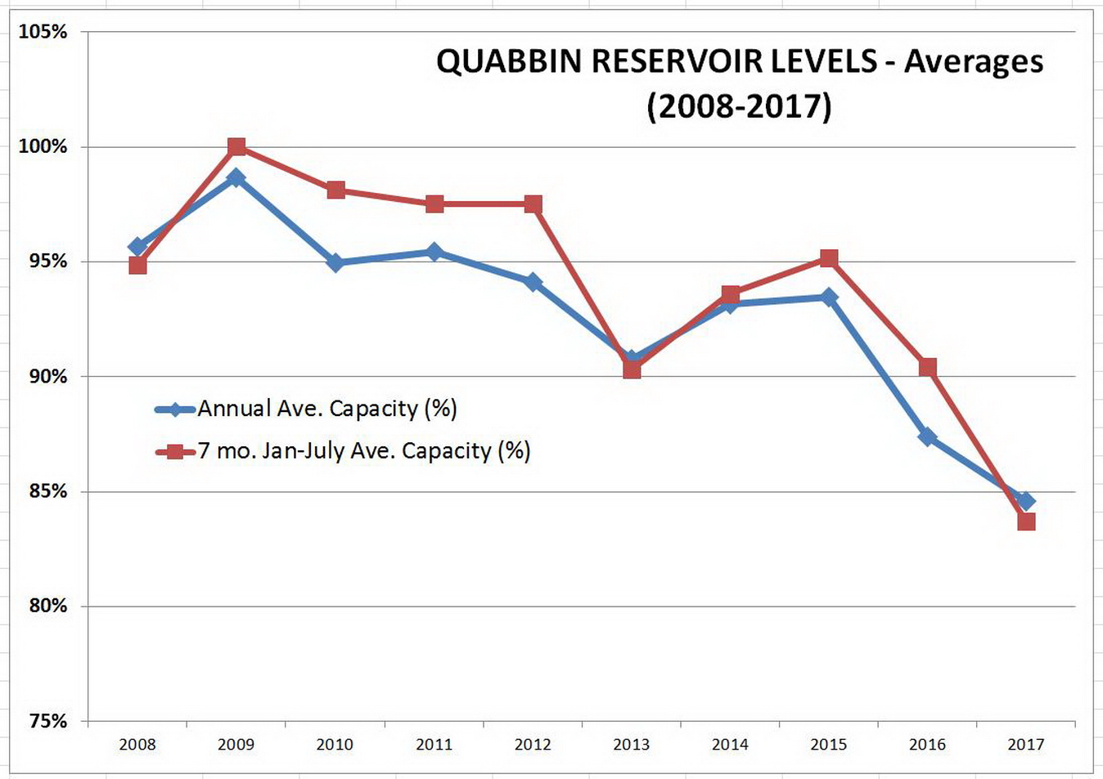
The MWRA Serves about 65% of Massachusetts
The MWRA’s largest reservoir, the Quabbin, is experiencing the effects of drought and growing demand with more towns joining the system and population movement into Greater Boston.

Slide 7
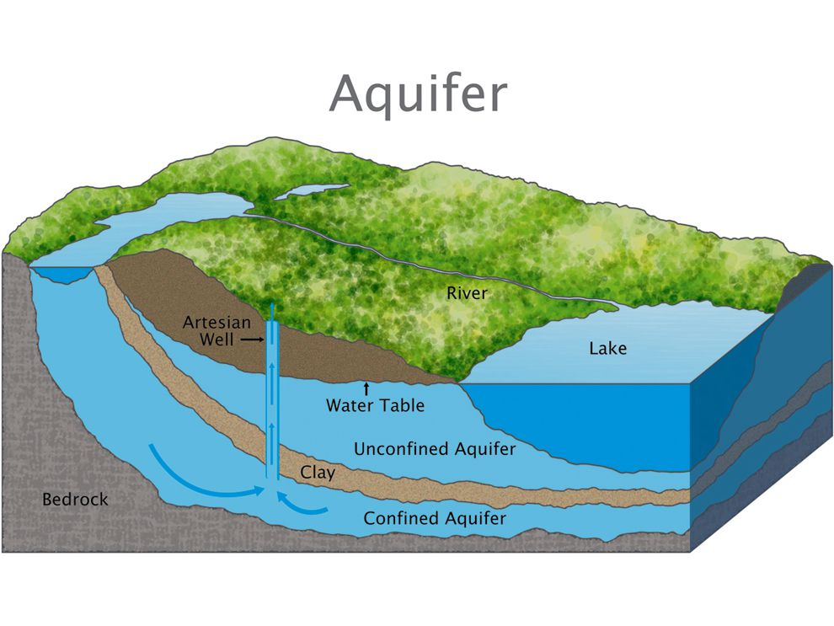
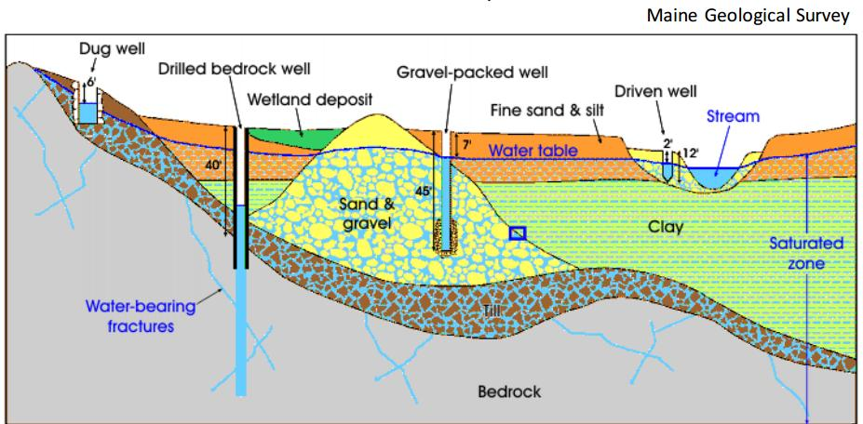
Understanding Dover’s Groundwater
Dover straddles two river basins, the Charles River Basin and the Boston Harbor/Neponset River Basin
Groundwater aquifers closely correspond to these surface water delineations
Every well in Dover draws from these two aquifers, whether the well is deep or shallow, or whether it is a large well servicing a Public Water Supplier or a residential well on private property

Slide 8
Withdrawals from Dover’s Groundwater
(by household)

Slide 9
Regulation of Public Water Suppliers by DEP
Does NOT happen due to DEP’s limited staffing and budget constraints
Water conservation measures mandated in PWS permits are not enforced or even monitored for compliance
Withdrawals above permitted limits occur regularly and are not addressed by DEP
PWS customer base continues to expand without any review or analysis by any authority, or any regard to implications to abutting property owners and groundwater supply

Slide 10
Top 5 Reasons to Fund Hydrology Study
There is anecdotal evidence (dry wells and disappearing streams) that there may be a developing groundwater shortage in Dover.
Availability of groundwater is critical to our ability to get water from our wells, as well as to protect property value.
Understanding our groundwater situation will allow Town boards and commissions to better assess and regulate new development.
Without professional scientific data and analysis, we cannot enlist DEP’s enforcement authority to address excessive withdrawals.
We want to be proactive in light of recently enacted regulations in 2018 and anticipated DEP regulations that will restrict water usage in the future.

Slide 11
Scope and Benefits of the Hydrology Study
Generate a graphical information system (GIS) map that identifies location and data regarding:
Public water supply wells
Private water supply wells
Water distribution infrastructure
Surface water
Installation of 15-20 new groundwater monitoring wells throughout the town (currently only one public monitoring well exists). This will allow Dover to:
Continuously measure groundwater elevation and track changes in groundwater elevation over time
Sample now and annually to assess existing and future contamination

Slide 12
Scope and Benefits of the Hydrology Study (cont.)
Infrastructure and monitoring program to generate an expert opinion regarding the impact to our water supply from:
More dense development
Geologically problematic well yield areas
Increased pumping from public water supply wells
Environmental contamination
Generate data that can be used to inform future decision-making including:
Conservation-based regulatory reform
Potential impact from new development
Water resource contingency planning

Slide 13
Hydrology Study Cost Estimates First Year - $75.00/household
TASK | LABOR – RESEARCH & ANALYSIS | LABOR - FIELD | DRILLING EXPENSES | LAB EXPENSES | OTHER EXPENSES DESCRIPTION | OTHER EXPENSES C0ST | TOTAL
Research and Compile Existing Data | $8,000-10,000 | $0-$0 | $0-$0 | $0-$0 | n/a | $0-$0 | $8,000-10,000
Develop GIS Layer | $25,000-$28,000 | $0-$0 | $0-$0 | $0-$0 | GPS Equipment Purchase | $4,000-$5,000 | $29,000-$33,000
Install Monitoring Wells | $0-$0 | $10,000-$12,000 | $15,000-$20,000 | $10,000-$12,000 | Field Expenses | $500-$1,000 | $25,500-$33,000
Monitor and Test Groundwater | $5,000-$6,000 | $10,000-$12,000 | $0-$0 | $10,000-$12,000 | Pressure Transducer Purchase | $12,000-$15,000 | $37,000-$45,000
Report Preparation (First Year) | $25,000-$28,000 | $0-$0 | $0-$0 | $0-$0 | Report Production | $500-$1,000 | $25,500-$29,000
TOTAL | $63,000-$72,000 | $20,000-$24,000 | $15,000-$20,000 | $10,000-$20,000 |  | $17,000-$20,000 | $125,000-$150,000

Slide 14
Hydrology Study Cost Estimates Subsequent Years - $10.00/household
$10,000 - $20,000 per year to be administered by Board of Health
Cost includes:
Support continued monitoring of groundwater elevations
Targeted groundwater sampling for areas of concern, either quality or quantity
Update GIS “water layer”
Preparation of an annual report

Slide 15
Conclusion:
Approving Funding for the Hydrology Study
Protect Dover’s groundwater supply, an irreplaceable resource that is critical to preserving property values
Evaluate the impact to existing residents of new developments that seek to draw water from existing PWS
Request DEP to enforce existing water conservation measures in PWS permits & regulate withdrawals that exceed permitted levels
Assess the impacts of environmental contamination from hazardous substance releases in areas where the groundwater monitoring wells exist
Respond proactively to pending legislative initiatives that will force Massachusetts communities to address water conservation
15

Slide 16
Dover Board of Health
Water Resources Study Committee
End of Town Meeting Presentation

Slide 17
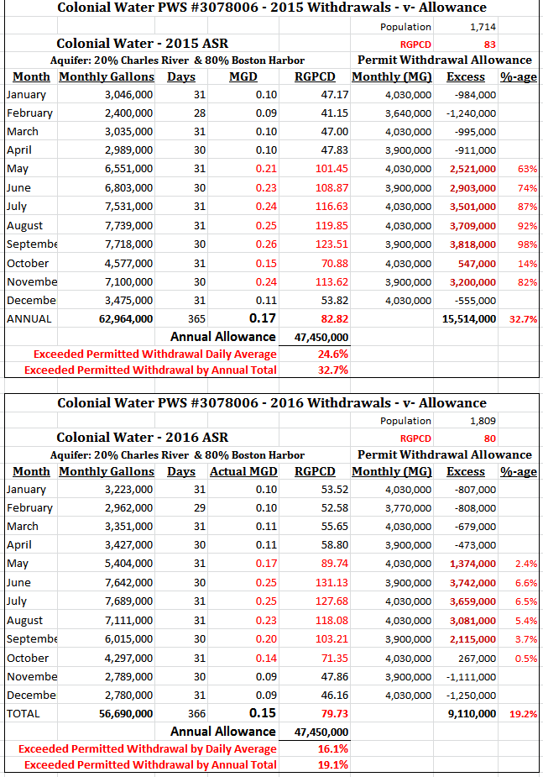
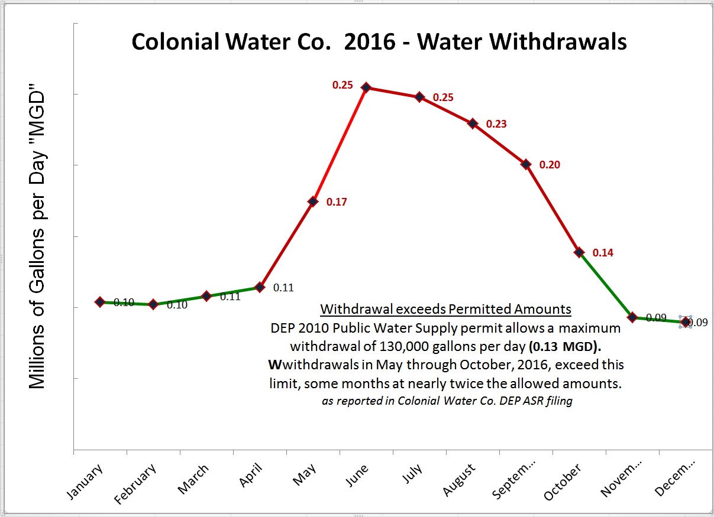

Slide 18
Elm Bank Aquifer & Dover’s Rights
1986 Acts Chapter 624 gave Dover, Needham, Natick, & Wellesley (and only these 4 towns) the right to withdraw water for public use from Elm Bank.
1986-1992 - Completion of agreements allowing Natick to develop a well source at Elm Bank in Dover, with Dover retaining the right to participate.
Today, Dover could proceed to develop a Public Water Supply Distribution System using that wellhead.
Costs of installing water mains under Dover streets would be not less that $975,000 per mile using the last available unit cost estimate in 1997.
Per household connection costs would run to $1,000-$1,500
Pumping and other capital costs not estimated at this time.
Any developer of property would have right to a connection; no need any longer for private wells.
18
18
18

Slide 19
State Sponsored Funding & Grants
In FY18 (2017/2018) the Mass. State budget carried as an outside line item an allocation of $30,000 for the Dover BOH/WRSC – unfortunately the Governor chose to not fund ALL outside line items.
FY19 – Going forward – July, 2018 –
Rep. Denise Garlick has resubmitted the request.
Senator Mike Rush will be following with similar action.
Mass. DEP Municipal Vulnerability & Climate Change program grants. This year DEP opened and closed the application calendar in 3 weeks – April 13 to May 4 – too short for Dover to complete given the Grants & Gift program in place in the Town House.
BOH will proceed this year to become certified as MVP (“Municipal Vulnerability Preparedness”) participant. Typical funding is to $75,000/year.
19
19
19

Slide 20
Massachusetts Water Law
Doctrine of Prior Appropriation – Common Law
First person to take a quantity of water from a water source for "beneficial use“ has the right to continue to use that quantity of water for that purpose.
Doctrine of Correlative Rights - Common Law
Landowner limits to a reasonable share of common source of groundwater.
Legislative Law since 1970’s
1972 Wetlands Protection Act, Amended 1996 & 2012 MGL c. 131 §40
DEP Regulations: 310 CMR 10.00
1984 Interbasin Transfer Act
1985 Water Management Act MGL c. 2 §1G update 2014, 310 CMR 36.00
Case Law
1986: SJC “Reasonable Use” limitation
2016: SJC - Reynolds v. Zoning Board of Appeals Stow, MA upholds rights of abutters
Local Town Law
Dover BOH does not regulate Private Wells, has no authority over PWS

Slide 21
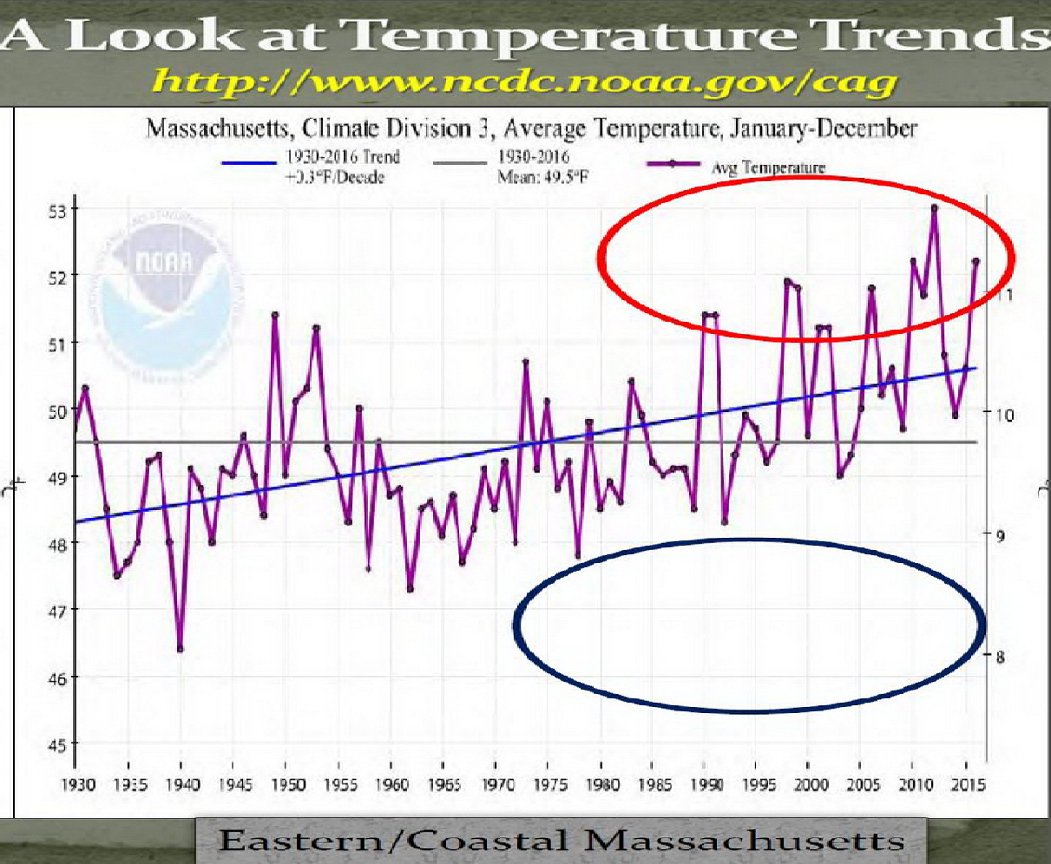
Long-Term Trend to Higher Temperatures

