Slide 1
MBTA Communities Act & Dover
Sec. 3A of Massachusetts General Law
Chapter 40A

Slide 2
Basic Facts about this law:
Signed into law by Baker administration, 2021
Requires 177 communities (adjacent to MBTA service) to update their zoning to allow some multi-family housing by-right
Failure to comply makes a community ineligible for certain state funding programs
Could also result in the loss of federal dollars
“Cities and towns that don’t comply with the MBTA Communities Act by allowing for more housing production will not be eligible for community project funding through the congressman’s office” Auchincloss’ office said in a statement.
Notes:
The MBTA Communities Act was signed into law by Charlie Baker’s administration in 2021, with the intention of creating more reasonably-priced homes near transit.
The law requires every one of the 177 communities that are adjacent to MBTA service to update their zoning to legalize the construction of some multifamily housing.
Communities that fail to comply will be ineligible for certain state funding programs, including the Housing Choice Initiative, Local Capital Projects Fund, MassWorks, and HousingWorks
The following discretionary grant programs will take compliance with Section 3A into consideration when making grant award recommendations:
Community Planning Grants, EOHLC,
Massachusetts Downtown Initiative, EOED,
Urban Agenda, EOED,
Rural and Small Town Development Fund, EOED,
Brownfields Redevelopment Fund, MassDevelopment,
Site Readiness Program, MassDevelopment,
Underutilized Properties Program, MassDevelopment,
Collaborative Workspace Program, MassDevelopment,
Real Estate Services Technical Assistance, MassDevelopment,
Commonwealth Places Programs, MassDevelopment,
Land Use Planning Grants, EOEEA,
Local Acquisitions for Natural Diversity (LAND) Grants, EOEEA, and
Municipal Vulnerability Preparedness (MVP) Planning and Project Grants, EOEEA

Slide 3
$818,095 in Grants, 2024
Massachusetts Electric Vehicle Incentive Program Public Access Charging Grant: $50,000
Massachusetts Community Compact Municipal Fiber Grant: $202,168
Massachusetts Office of Grants and Research: $18,440.78
Massachusetts Executive Office of Elder Affairs Formula Grant: $20,258
Massachusetts Community One Stop for Growth Grant: $40,000
Massachusetts Housing Partnership Grant: $10,000
Massachusetts 911 Grants: $51,573.68
Massachusetts Executive Office of Public Safety Bulletproof Vest Program Grant: $2,237.50
Massachusetts Cultural Counsel Grant: $5,500
MassTrails Grant: $184,760
MassDOT Municipal Pavement Grant: $217,261
Massachusetts Department of Fire Services Firefighter Safety Equipment Grant: $9,896.22
Massachusetts Department of Environmental Protection Sustainable Materials Recovery Program Grant: $6,000
Notes:
And speaking of grants…..here’s a lookback of grant funding received by Dover in 2024…..
The following discretionary grant programs will take compliance with Section 3A into consideration when making grant award recommendations:
Community Planning Grants, EOHLC,
Massachusetts Downtown Initiative, EOED,
Urban Agenda, EOED,
Rural and Small Town Development Fund, EOED,
Brownfields Redevelopment Fund, MassDevelopment,
Site Readiness Program, MassDevelopment,
Underutilized Properties Program, MassDevelopment,
Collaborative Workspace Program, MassDevelopment,
Real Estate Services Technical Assistance, MassDevelopment,
Commonwealth Places Programs, MassDevelopment,
Land Use Planning Grants, EOEEA,
Local Acquisitions for Natural Diversity (LAND) Grants, EOEEA, and
Municipal Vulnerability Preparedness (MVP) Planning and Project Grants, EOEEA

Slide 4
$990,075 in Grants, 2023
MA Executive Office of Elder Affairs Formula Grant: $18,240
MA 911 Grant: $68,635
MA Department of Environmental Protection Grant (stream crossings): $165,000
MA Department of Environmental Protection Grant (stormwater): $99,000
Economic Development Bill Earmark: $120,000
MA Sustainable Materials Recovery Program Grant: $7,200
MA Executive Office of Energy and Environmental Affairs Grant: $12,000
MA Green Communities Competitive Grant Program: $500,000
These grants were awarded to various departments and projects in the town, including the Council on Aging, Police Department, Planning Board, and Community Center, as well as for environmental and infrastructure improvements
Notes:
2023…..

Slide 5
$2,368,274 in Grants, 2022
Federal Omnibus Spending Bill: $2,000,000
MA Division of Ecological Restoration: $60,000
MA Executive Office of Energy and Environmental Affairs: $75,000
MA Commonwealth Compact: $113,274
MA Omnibus Spending Bill: $120,000
These grants were awarded for various projects including the design of the Centre Street bridge, a feasibility study for culvert replacement, a water sustainability study, installation of fiberoptic network in municipal buildings, and water main repairs.
Notes:
And 2021……

Slide 6
Future Funding?
Online Permitting Software: Up to $200,000
Centre Street Bridge Construction: Up to $12,953,780
This list is in development
Notes:
But looking ahead is where it gets pretty stressful….this list in development

Slide 7
Legal Backdrop: The Court has ruled on this issue
Voters in the Town of Milton rejected MBTA Zoning
The Attorney General then filed a lawsuit against the Town
On January 8th, 2025, the MA Supreme Judicial Court issued a landmark decision on this case: all MBTA Communities are required to comply with the law, and the attorney general has authority to enforce it.
Notes:
But it’s not just money.
There’s been a lot of talk in the news about non compliant communities. Milton led the way, and the MA Supreme Judicial Court has made its ruling on the Milton case
So it is the opinion of the PB that non compliance is not an option, and we are working hard to develop options and strategies that will bring us into state compliance but that will also reflect the best interests of our community

Slide 8
Why is the State doing this?
Encourage more housing to be built
Remove barriers to multi-family residential near transit
Streamline the approvals process
Most multi-family housing in Massachusetts is subject to town-specific, unpredictable, time-consuming permitting processes.
Often requires a special permit, rezoning, or a 40B
Notes:
Lots of reasons but here are three that are often cited
Our own Multi Family Bylaw has been on the books since (xxx) and has never been used. It requires a special permit from the PB

Slide 9
177 Cities & Towns
Rapid Transit | Those with T-Stations
Commuter Rail | Those with Commuter Rail
Adjacent Community | Those without a station, but adjacent to a municipality with one
Adjacent Small Town | Adjacent Communities of 7,000 people or less or a population density of less than 500 persons per square mile
Notes:
List some other adjacent small towns
Sherborn
Needham
Newton
Milton
Carlisle – Adjacent Small
Medfield

Slide 10
Statewide Requirements for all MBTA Communities:
Must have at least one zoning district in which Multi-family housing is permitted by right (which can include Site Plan Review)
Minimum gross density of 15 units per acre
Located not more than 0.5 miles from a transit station, if applicable
No age restrictions and suitable for families with children (i.e. no bedroom or occupancy caps)
Parity with other uses – multi-family housing cannot be required to meet higher standards than other permitted uses
Compliance deadlines vary
Notes:
15 units per acre, with a goal of 102 units, translates to just over 7 acres speaking very broadly

Slide 11
What is multi-family housing?
“a building with 3 or more residential dwelling units or 2 or more buildings on the same lot with more than 1 residential dwelling unit in each building”
–MGL c. 40A §1A
Notes:
“These are the types of homes that might be a better fit for people at different stages of their life: Elderly, empty-nesters, young adults, single-parents, etc.

Slide 12
What do we actually need to do?
Select a district (or districts) to be zoned for MBTA compliance
Write a zoning bylaw regulating this specific type of development in the proposed district
Vote at Town Meeting to approve this bylaw and Zoning map amendment before December 31, 2025

Slide 13
Compliance Requirements for Dover (Adjacent Small Town)
Minimum multi-family housing unit capacity: | 102 units (5% of Dover’s 2020 housing stock)
Minimum land area: | No minimum size required for Dover, but if the area is less than 5 acres it must all be contiguous.
Minimum gross density in the zoned area: | 15 units per acre
Location requirements: | None
Compliance Deadline: | December 31, 2025
Notes:
Adjacent Small Town (Adjacent Communities of 7,000 people or less or a population density of less than 500 persons per square mile)
If anyone asks, if the total area of the district is more than 5 acres, at least 50% must be contiguous.

Slide 14
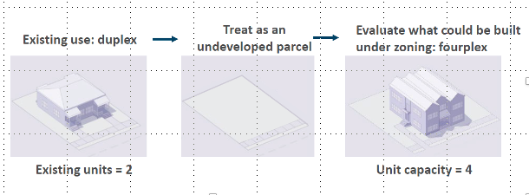
What does “Unit Capacity” mean?
Although some units may already exist, “unit capacity” for any given parcel may be higher or lower than existing development on the site.
The unit capacity of each parcel is measured as if that parcel was undeveloped

Slide 15
Section 3A does not:
Require that multi-family housing be built (compliance is based on zoning that meets standards);
Compel communities to design or pay for new infrastructure to accommodate future multi-family development in a 3A district;
Supersede or override Dover wetlands or Title V laws.
Notes:
To put a fine point on this:
From Nina email (2/24/26) I am 100% comfortable with that statement until a Judge tells me I’m wrong. Now, to be clear, you cannot just pass a regulation that effectively requires only multi-family housing to comply with some rigorous town-specific conditions. But, as long as they apply to all housing/development, it can also apply to proposals under Section 3A. I apologize for not being able to say definitively that a court will agree with us – some things with this law are TBD.

Slide 16
How has Dover been preparing?
In 2023 Dover contracted Horsley Witten Group through a technical assistance grant to MBTA Communities to help us with this process:
Initial locations were identified as potential MBTA overlay zones - a starting point for discussion.
Worked with Horsley Witten and town counsel to develop a first draft MBTA Communities Act Bylaw that can be reviewed on the Town of Dover website
Timeline of activities to date is on the website
Notes:
Many many months of work to date

Slide 17
Where might an MBTA District go?
Step 1 | Determine district boundaries. Where might multi-family residential be appropriate? No minimum size required for Dover, but if the area is less than 5 acres it must all be contiguous.
Step 2 | Determine some dimensional requirements. How tall should buildings be in this district? What setbacks? What density?
Step 3 | Ensure all zoning policy for the district complies with the law (affordable housing, policies that would limit family-sized units, etc.)
Step 4 | Enter this data into the Compliance Model and “test” different iterations. Find a scenario that meets the Town’s needs as well as state law.
Notes:
Starting to imagine a proposed location….we went through a 4 step process with Horsley Whitten
Step 1: Step 2: Step 3: Step 4:

Slide 18
Step 1: Identifying Possible Locations
Look at Pre-Existing Developments
Identify a single area where compliance can be met
Look at undeveloped property where density would be less likely to disturb residential neighborhoods
Factor in proximity to town services
Consider infrastructure requirements
Consider State compliance criteria carefully
Notes:
So here is where the PB started, by beginning to imagine and explore some locations that might fit the bill and allow us to zone a compliant area with these elements in mind…..

Slide 19
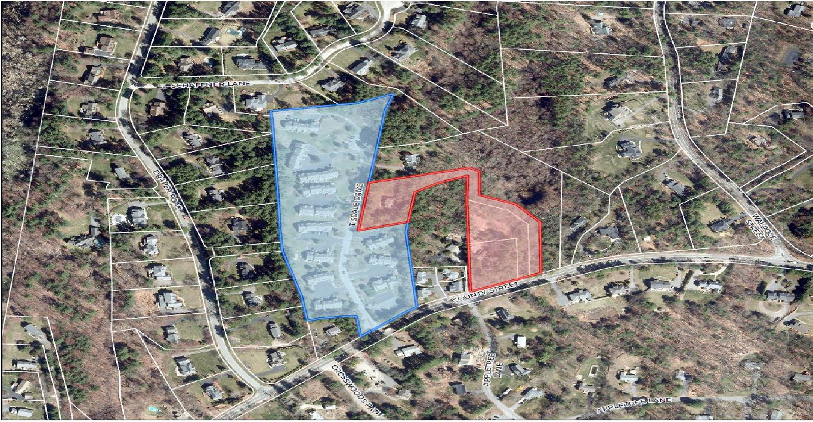
HW was initially asked to look at (4) existing development sites
County Court (Blue) and The Pastures (Red)

Slide 20
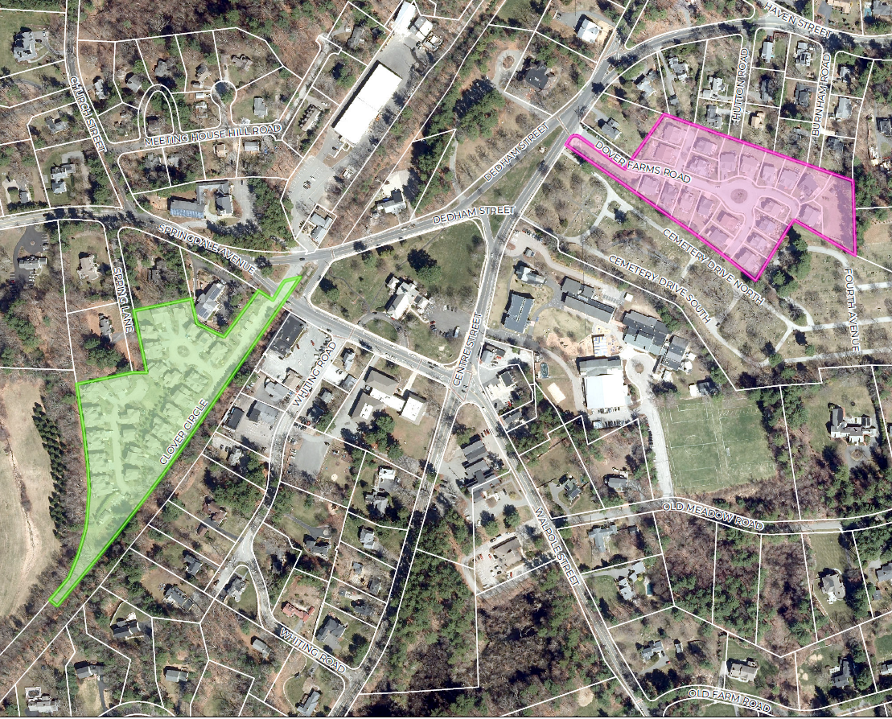
HW was initially asked to look at (4) existing development sites
And two near Town Center: Dover Farms (Pink) and The Meadows (Green)
The Meadows (Green) and Dover Farms (Pink)

Slide 21
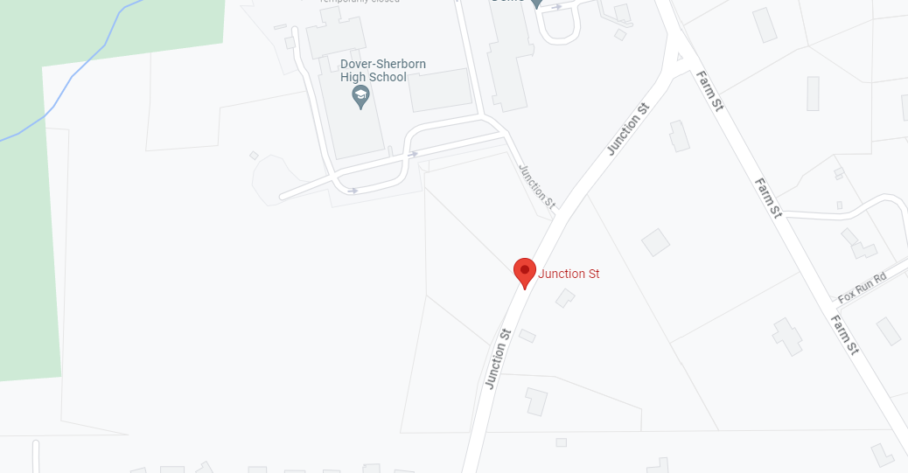
HW was then asked to look at Junction Street
Property that was being explored by Pulte Homes in Summer/Fall 2024

Slide 22
Step 2: Proposed Dimensional Requirements (modelled after existing 185-42 Multi-Family Residence District)
Minimum Lot Size: 20,000 SF
Minimum Street Frontage: 100 feet
Maximum Building Height: 2.5 stories and 35 feet
Maximum Lot Coverage: 25%
Minimum Open Space: 40%
Minimum Setback, Front: 50 feet
Minimum Setback, Side: 50 feet
Minimum Setback, Rear: 50 feet
Notes:
We already have an existing multi-family residence district on our Town Code. It is not MBTA compliant, however. (185-42), We decided to ask our consultant to model the bylaw after these already approved dimensional requirements.

Slide 23
Step 3: Ensure Zoning Policy Complies with the Law
Horsley Witten and Town Counsel reviewed other draft zoning amendment policies to ensure they comply with the law.

Slide 24
Step 4: Compliance Modelling:
Released by the State in August 2022
Provides step by step instructions for compliance
Includes a “Compliance Model” that calculates whether a municipality’s zoning and other policies comply with the law
For more information on the requirements related to Section 3A: www.mass.gov/info-details/multi-family-zoning-requirement-for-mbta-communities
Specific compliance guidelines:
www.mass.gov/doc/compliance-guidelines-for-multi-family-zoning-districts-under-section-3a-of-the-zoning-act/download

Slide 25


Run the compliance Model: What did we learn?
 | District Area (no minimum required) | Modeled Unit Capacity (102 units required) | Dwelling Unit per Acre (15 required) | Does this location Comply?
County Court | 10 acres | 227 | 22.8 | YES
The Pastures at Dover | 3.8 acres | 81 | 22 | NO
Dover Farms | 4.9 acres | 11 | 2.3 | NO
Junction Street | 17.2 acres | 267 | 19.1 | YES
The Meadows | 5.3 acres | 122 | 22.8 | YES
Notes:
HW punched the information into the compliance model and here is what we learned
This knocked two of the existing locations out of the consideration set

Slide 26
Next Steps:
Dover must pass a zoning bylaw update by December 31, 2025, or risk losing necessary grant funding or facing legal action
Over the next several months, the Town of Dover and Horsley Witten Group will conduct several open information sessions to address resident ideas and feedback
1st Public Information Session: March 25 on Zoom
Town Survey to collect feedback and input
Special Town Meeting September 29, 2025, to vote on the MBTA Compliance Act Zoning Bylaw
Simple majority required to approve

Slide 27

Discussion
Any thoughts or comments?

