Slide 1
Planning Board Articles for ATM 2025
April 9, 2025
The Planning Board has submitted their Articles for Town Meeting as follows:
1. Modification to Floodplain District (185-44)
2. Modification to various clarifying administrative edits to the Zoning Bylaws (185)
3. Modification to Accessory Dwelling Units (185-43)
4. Modification to Site Plan Review (185-36)
5. Acceptance of easements

Slide 2
Article 19
Modification to Floodplain Bylaw and Map 185-44 (2/3 vote)

Slide 3
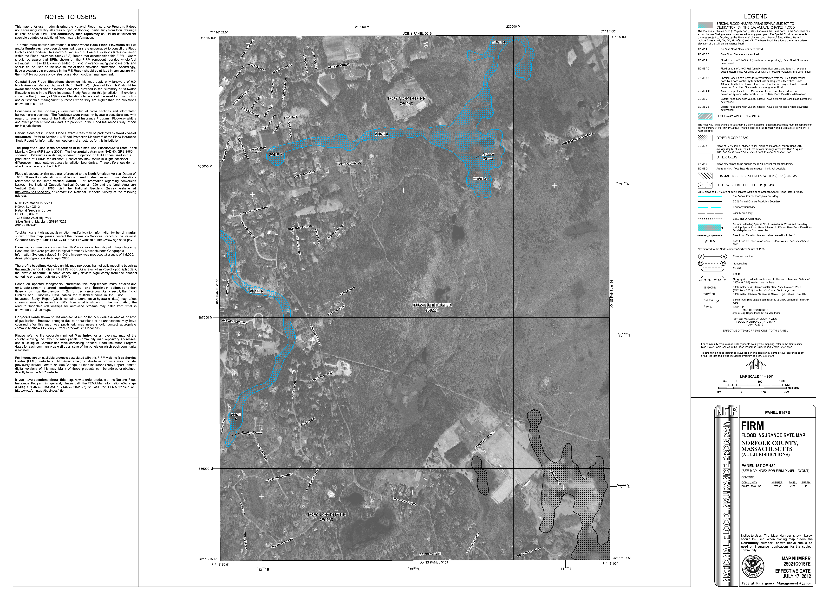
Overview of Updates
A Flood Insurance Rate Map (FIRM) is an official map of a community that displays the floodplains, special hazard areas, and risk premium zones, as delineated by the Federal Emergency Management Agency (FEMA). These maps must be adopted under the local zoning for communities to participate in the National Flood Insurance Program.
FIRM maps are updated every FIVE to TEN years. The last update was 2012 but the current effective maps are from 2021.
Notes:
New FIRM have no changes except the date and address

Slide 4


Specific Bylaw Updates
To update the map references to the 2025 Flood Insurance Rate Maps and Flood Insurance Study prepared by the Federal Emergency Management Agency; and
To update the text of Section 185-44 to remain in compliance by updating the map date.
The new map is effective July 8, 2025.

Slide 5
Voting Implications
Passes by 2/3 majority
Fails to pass by 2/3 majority
The Town and its residents are able to continue to participate in the National Flood Insurance Program
Dover will be removed from the National Flood Insurance Program negatively impacting local homeowners requiring flood insurance in 2025
The proposed bylaw language was provided by DCR and should not be modified.
Failure to accept the new language as dictated by DCR and FEMA will nullify participation in the NFIP.

Slide 6
Article 20
Modification to various clarifying administrative edits to the Zoning Bylaws (Ch 185) per the request of the Building Department (2/3 vote)

Slide 7
Overview
SUMMARY OF PROPOSED CHANGES
Add a footnote to Maximum Lot Coverage in the Ch 185-17 Schedule of Dimensional Requirements Table that will draw attention to Section 116-3 Groundwater Protection District.
Add a footnote to setbacks in the Schedule of Dimensional Requirements Table to highlight Section 185-25 - accessory structures require half the setback
Add to Ch 185-5 definitions: small family daycare, large family daycare. This will tie the State Building Code to Dover’s definitions

Slide 8
Voting Implications
Passes by 2/3 | Fails to pass by 2/3
Small revisions and clarifications will provide clarifications within the Bylaw and allow for easier use for residents and contractors | Inconsistencies will remain within the Bylaw and certain definitions and clarifications will remain absent, causing confusion for residents and contractors

Slide 9
Article 21
Modification to Accessory Dwelling Units 185-43 (50% vote)

Slide 10
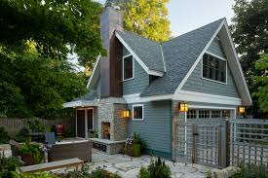
What is an Accessory Dwelling Unit (ADU)
A residential living unit that is subordinate to the principal residence on a single-family lot:
  Self-contained - accessory unit with its own sleeping, cooking, and sanitary facilities
  Separate entrance
  Can be attached to or detached from the primary residence
Notes:
ADUs may be located in converted interior space (basements, attics, part of main living floors) OR converted garages OR detached buildings (barn, carriage house, detached garage) OR attached to the main single family home

Slide 11
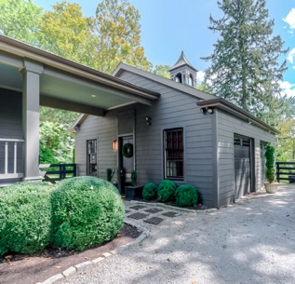
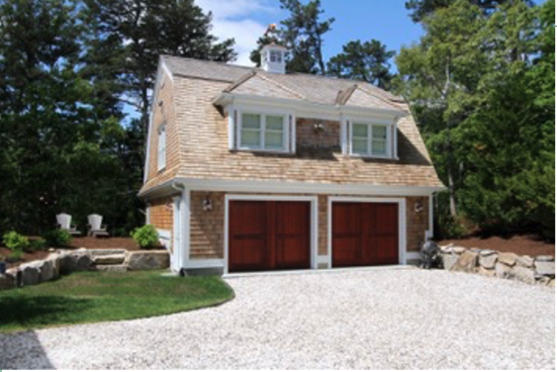
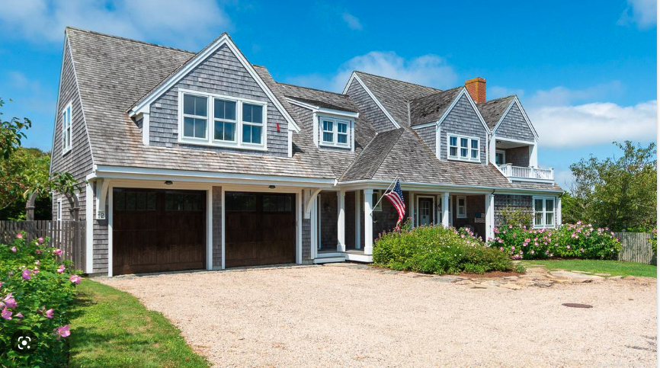
Notes:
The idea probably feels familiar to many of you
Also known as In law apartment, Granny flat
Gaining popularity in Massachusetts and beyond.
In fact, over 40 communities in Massachusetts now allow ADUs

Slide 12
Background and Purpose
1986: ADU bylaw approved in Dover by ATM 1986
2023: Updates to the ADU Bylaw approved in Dover by ATM 2023 to build upon Build upon
Since the 2023 update, 7 ADUs have been permitted in Dover
2024: MA Legislature passed the Affordable Homes Act, effective February 2, 2025, allowing:
  Prohibited any Special Permit by designating attached and detached ADUs by-right in all single-family residential zoning districts, state-wide
  Prohibited requiring owner-occupancy of the main dwelling or an ADU
  Prohibits regulating ADU specific Architectural Design guidelines
This article amends Dover’s ADU Zoning Bylaw, bringing it into compliance with State requirements by amending the owner occupancy requirement and the need for a Special Permit for detached ADUs.

Slide 13
Summary of Proposed Changes
Remove requirements for Special Permit/discretionary approval for detached ADUs which makes all ADUs as right
Remove owner-occupied restrictions
Remove ADU architectural specific design guidelines (and use SPR process)
Update Ch 185-10.32 Schedule of Use Regulations to remove the Special Permit requirement for detached ADUs
Update Ch 185-10
  Remove Section 185-10.32 Detached ADU
  Re-title 185-10.31 to read Attached and Detached ADUs
Notes:
– need language for where in the new law this is required please put in notes section
G.L. c. 40A, §§ 1A and s. 3 - Subjects which zoning may not regulate; exemptions; public hearings; temporary manufactured home residences
Practically, this means that municipalities’ power to limit the erection of ADUs, or the
conversion of existing structures into ADUs, is greatly curtailed. For instance, cities and towns
may no longer impose owner-occupancy requirements on ADUs or primary dwellings on lots
containing ADUs, or otherwise “unreasonably restrict the creation or rental of an accessory
dwelling unit.”
Importantly, ADUs may still be subject to reasonable regulations including site plan review,
dimensional setbacks, bulk and height requirements, and prohibitions on short-term rentals. The
amendment also allows for limitations on parking, especially for those units close to public
transportation. Further, municipalities may still require a special permit for a property with more
than one ADU.

Slide 14
Removal of Owner Occupancy Requirement
D. Additional standards for ADUs.
(1) Maximum floor area. All ADUs approved under this section shall be accessory to the principal residence; the floor area shall not exceed 50% of the floor area of the principal residence, exclusive of any garage, unfinished attic, basement or shed attached to said principal residence, or 900 square feet, whichever is less.
(2) Owner occupancy. The owner of the property shall occupy either the principal residence or the Accessory Dwelling Unit on the property on which the ADU is located, except for bona fide temporary absences, at all times during which the ADU is rented.

Slide 15
Removal the Special Permit Requirement
C. Detached ADUs.
(1) Applicability of special permit requirement. A Detached ADU shall be defined as an Accessory Dwelling Unit that is located in a separate structure accessory to such single-family dwelling. An owner(s), or applicant with owner(s) consent, of a single-family dwelling in an R, R-1, R-2, B, M, M-P or R-M District may use a portion of the separate accessory structure as a Detached ADU upon receipt of and compliance with a Special Permit by the Board of Appeals. Submission requirements and procedures shall be in accordance with the Zoning Board of Appeals' rules and regulations.
(2) Site Plan Review by the Planning Board. An application for Site Plan Review shall be submitted to the Planning Board at least 10 days prior to submitting an application for a Special Permit to the Zoning Board of Appeals. The Zoning Board of Appeals shall receive a copy of the Site Plan Review application. The Planning Board shall submit a written report based on the results of this Site Plan Review to the Zoning Board of Appeals prior to their public hearing. The report of the Planning Board shall include any recommended conditions for a Special Permit related to the Site Plan Review.
(3) Special Permit from the Zoning Board of Appeals. An application for a Special Permit for a Detached ADU shall require a Public Hearing which shall be held according to the procedures outlined in § 185-52 of the Zoning Bylaw. After due consideration of the recommendations of the Planning Board, the Board of Appeals may grant a Special Permit as provided in this section, provided that the Detached ADU meets all the standards of Subsection D below, and all other requirements under the Zoning Bylaw.

Slide 16
Voting Implications
Passes by 50% | Fails to pass by 50%
The Bylaw will be updated to be in compliance with state regulations | State regulations will still remain in effect, but Dover’s bylaw will remain non-compliant. This can lead to confusion and additional costs by the applicant

Slide 17
Article 22
Modification to Site Plan Review 185-36 (2/3 vote)

Slide 18
Overview
REGULATORY CONTEXT
Currently, our Site Plan Review Bylaw (185-36) allows thirty (30) days for the Planning Board to review a Site Plan and issue a determination. If no decision has been voted upon within 30 days, and the applicant has not agreed to an extension, the application is automatically approved.
Due to the level of detail required for review, and the schedule of meetings of the Planning Board, we are proposing to extend the Site Plan review period from thirty (30) days to sixty (60) days. This will allow time for due diligence by the Planning Board and for earlier notification of abutters so their input can be more effectively considered

Slide 19
Voting Implications
Passes by 2/3 | Fails to pass by 2/3
Site Plan Review by the Planning Board will be extended from 30 days to 60 days to allow for more in-depth review of applications. | Site Plan Review will remain at 30 days and the Planning Board will continue to work toward completion within 30 days. Abutters’ timeframe for input to the Planning Board will be limited.

Slide 20
Article 23
ACCEPTANCE OF EASEMENTS (50% vote)

Slide 21
Overview
REGULATORY CONTEXT
EASEMENTS FOR ACCEPTANCE
The Town has periodically been granted the right to use portions of private property (easements) for trail access
The easements are proposed to be accepted at Town Meeting as a matter of clerical completion. This would ensure only a Town Meeting Vote could extinguish the easement, rather than the Planning Board, thereby better protecting the easement
Allowed uses range from general hiking, biking, to bridle path only. Some are open to general public while others are restricted to Dover residents or by permission only.
None require maintenance from the Town
This change does not impact the standing or legality of the easement

Slide 22
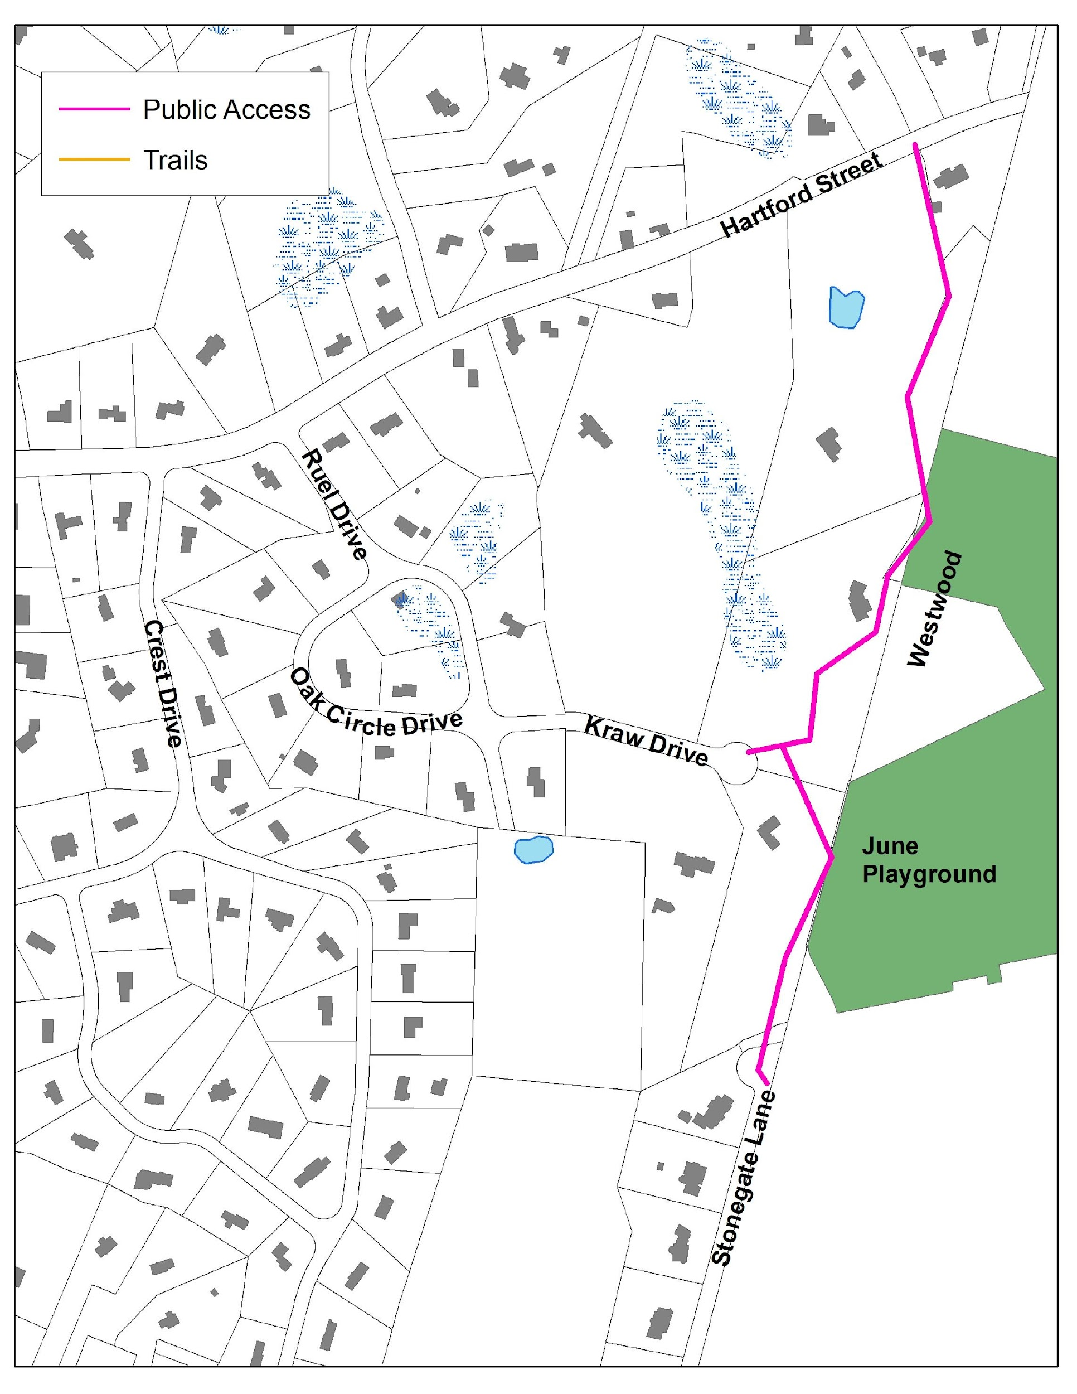
Bar-K Estates
1992
Properties Subject to Easements:
1.) 6 Hartford Street
2.) 16 Kraw Drive
4.) 17 Kraw Drive
Access easement for hiking, horseback riding, and cross-country skiing. Provides access from Stonegate Lane to June Playground (Westwood), and access from June Playground to Hartford Street.
Notes:
Be helpful to have the tax map # referenced – this is #24
Be good to show the land in Westwood that belongs to Westwood Conservation Commission is 20.15 ac lot, June Playground (Westwood #27-22) and Hale 27-25 (3.54 ac)
Just off the top left corner (just past where Burgess comes into Hartford), there is a Westwood Con Com property Mill Brook Conservation Area (19-9 with 6.13 ac and Dover 24-149 on MA GIS, 24-73B on tax map with 1.3 ac) This property leads into the bottom of Hale – there are trails on Hale that go down near the border with this Westwood property but there look like too many brook & wetlands to make it accessible, sadly. We should ask Eric if this is the case.

Slide 23
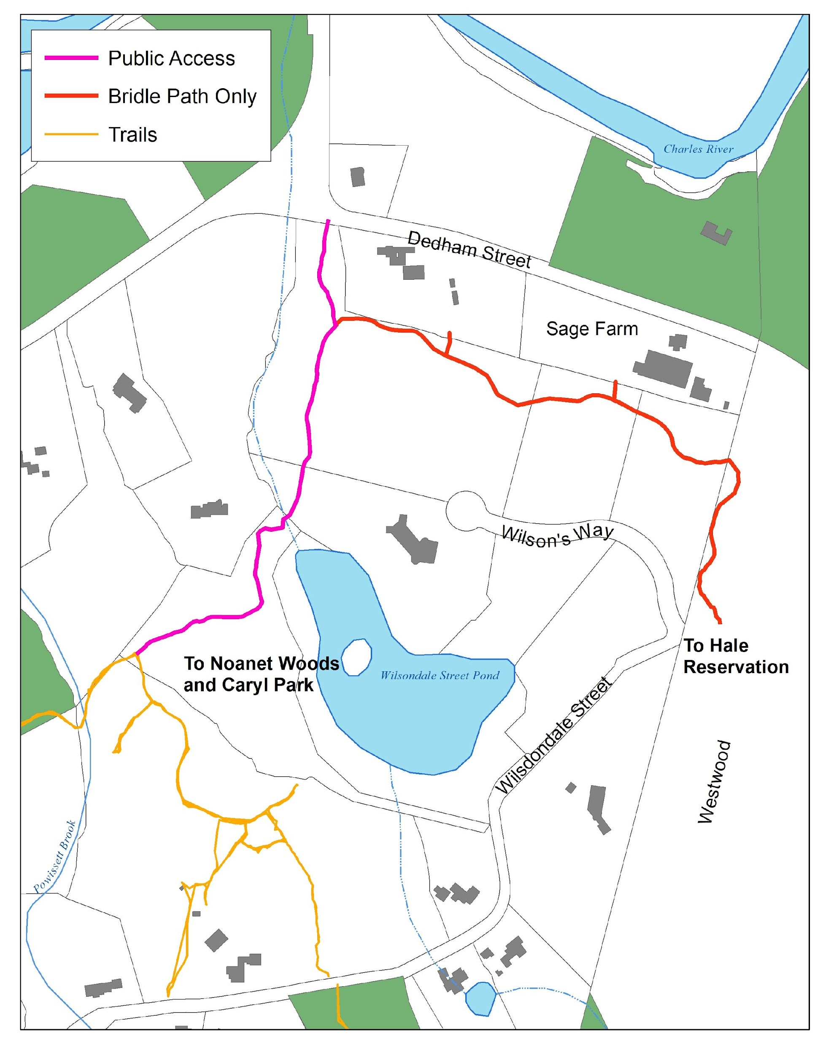
Wilson’s Way
2000/2017
Properties Subject to Easements:
1, 3, 5, 8 Wilson’s Way
Equestrian Uses only in red, general public access in fuschia.
Notes:
The segment from Dedham St to the Con Com land (8-8C) is for Public or Dover residents (forget which). Bisson was supposed to actually create it. I think there is supposed to be a public trail from the end of Wilson’s Way to the public trail as well. The Con Com land has access to Wilsondale St (which is dry, beavers willing).
The section that runs along the top of the property is Equestrian Only.

Slide 24
Voting Implications
Passes by 50% | Fails to pass by 50%
All easements remain in use as they are existing, a vote at Town Meeting will be required to extinguish easements in the future | All easements remain in use as they are existing, a vote by the Planning Board will have the authority to extinguish easements in the future
Notes:
On April 8, 2025 the Open Space Committee voted to support Article 24

